Slide 1
Azure Solution Alignment Workshop
Module 6 – Identity

Slide 2
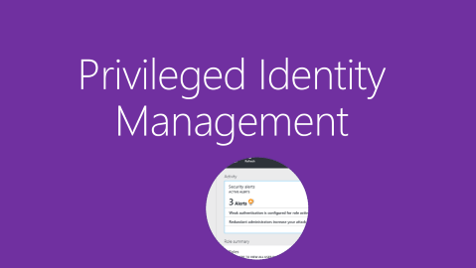
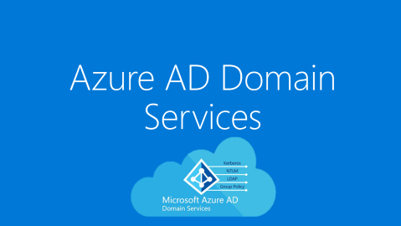

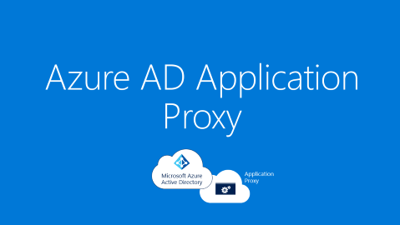
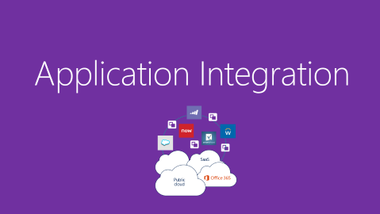
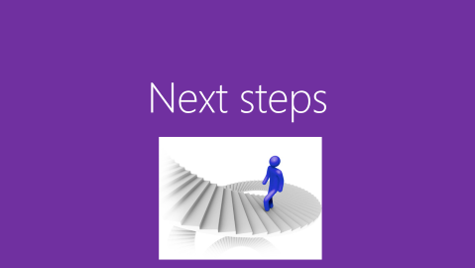
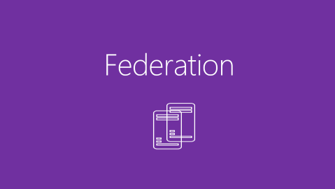
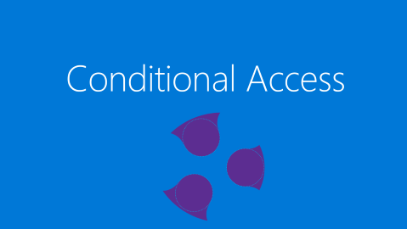
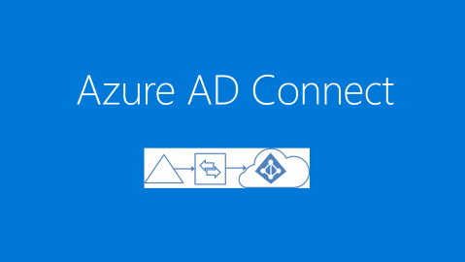
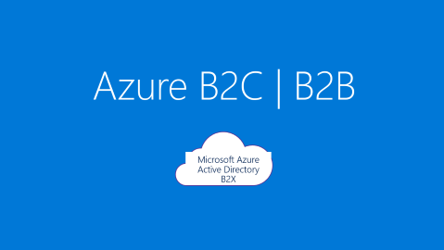
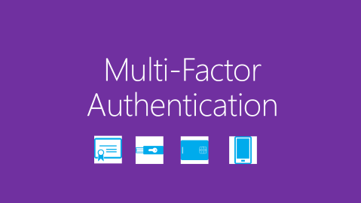
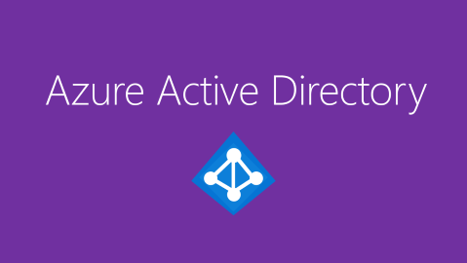
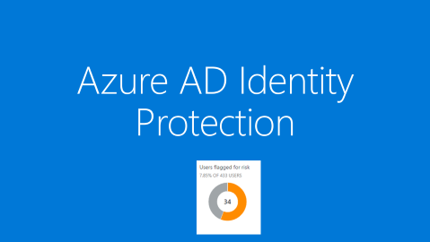
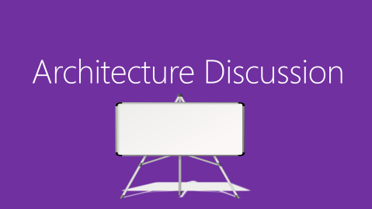
Identity Menu | Click on a topic
Notes:
If you want to go straight through these, start on the top left and go across left to right across each row. If any of the topics do not need to be discussed, or they are not interested in something, you have the option to hop around various sections depending on how much time you have. The MOST important topics are
Azure AD. This is by far the largest section and has the most content. Concepts such as the trust relationship between subscriptions and O365 and also administration are important to understand well and explain to the customer.
Azure AD Connect – or do they have or are they planning on doing synchronization and are they at the latest version?
Is federation in place? If so what are they using? If not, then this is an education for them. Conditional Access is sometimes a new topic either way – note that is another block to choose.
NOTE: if there are topics that they own and have well configured and managed, then you don’t necessarily need to dive into the slides, but instead use the Discovery section to ask questions about their current state. That is why it is recommended to do the discovery first. Then you may get what you need and determine which sections should or should not be presented.
If you click outside the boxes in the white area, the deck will just proceed as normal. But the Zoom effect is cool, so show and use it ☺ As you complete each topic, the Zoom will return you back to this menu.

Slide 3
Azure Active Directory
Notes:
Azure AD provides the core directory and identity management capabilities behind most of Microsoft’s cloud services, including:
Azure Subscription
Microsoft Office 365
Microsoft Dynamics CRM Online
Microsoft Intune
You will get an Azure AD directory when you sign up for any of these Microsoft cloud services. You can create additional directories as needed. For example, you might maintain your first directory as a production directory and then create another directory for testing or staging.

Slide 4
WHY IDENTITY IS IMPORTANT
81%
73%
80%
of breaches are caused by credential theft
of passwords are duplicates
of employees use non-approved apps for work

Slide 5

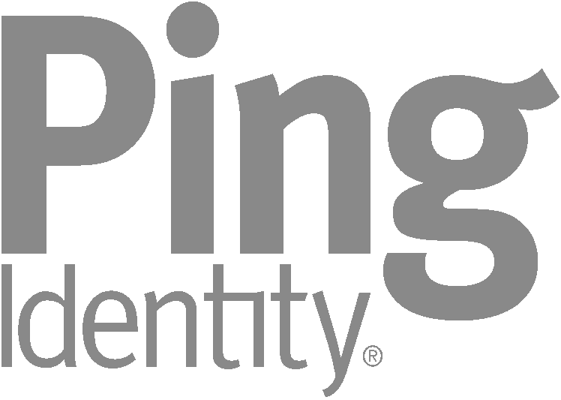

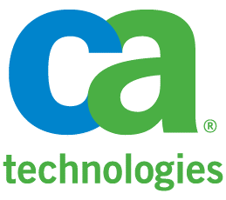
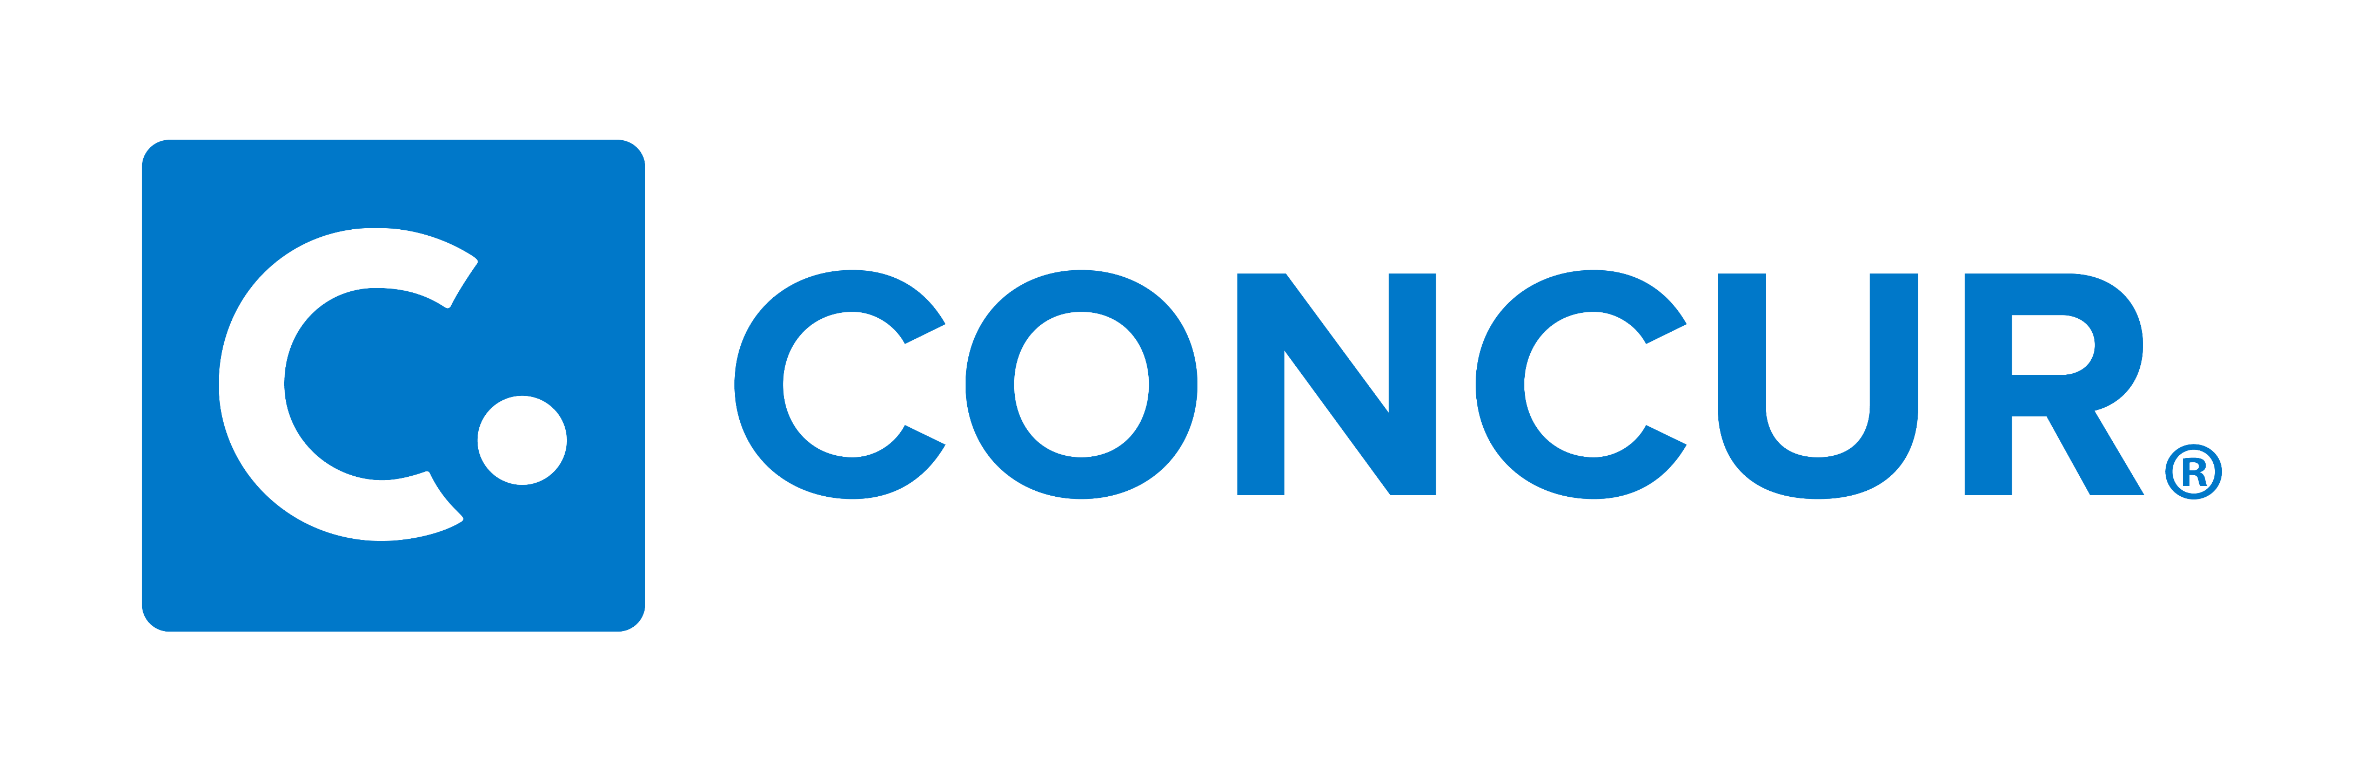
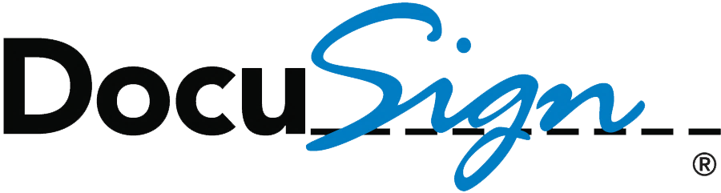






Identity as the Control Plane
Identity is the new Security Perimeter
Partners
Customers
Public cloud
Commercial IdPs
Azure
Microsoft Azure Active Directory
Consumer IdPs
Cloud
Windows Server
Active Directory
On- premises
Azure AD Connect
BYO

Slide 6
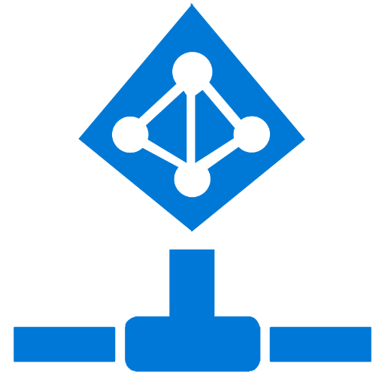
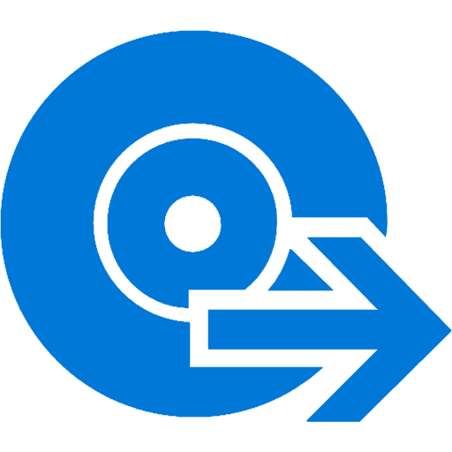
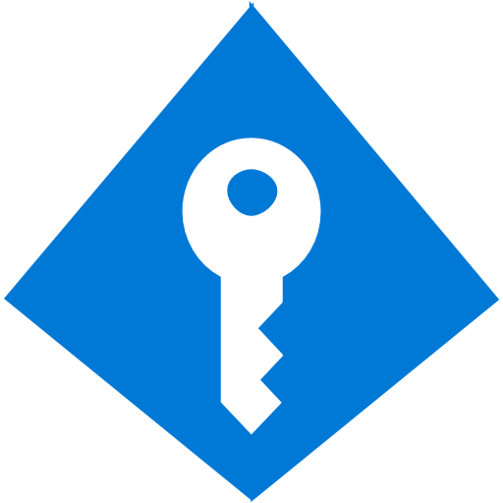
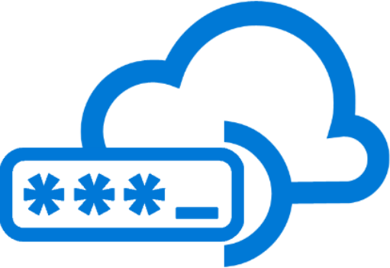


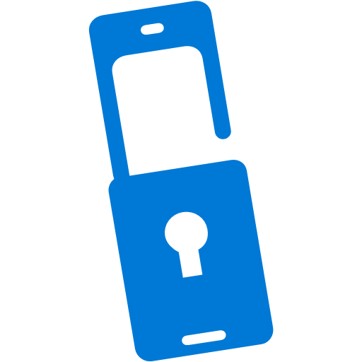





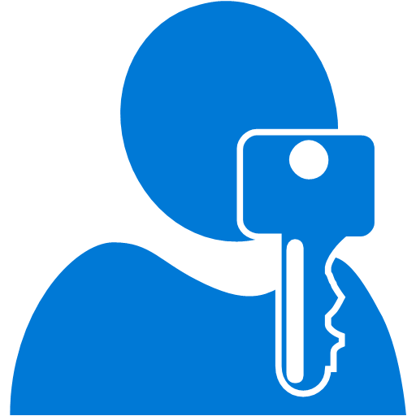
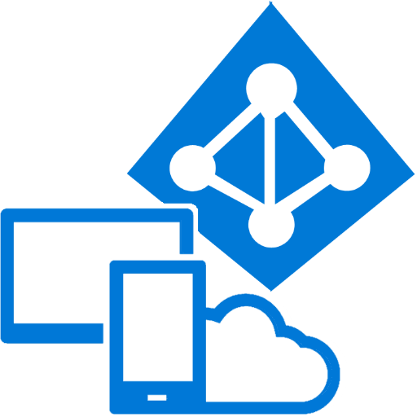
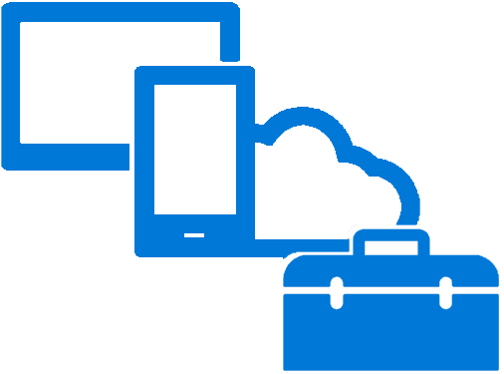
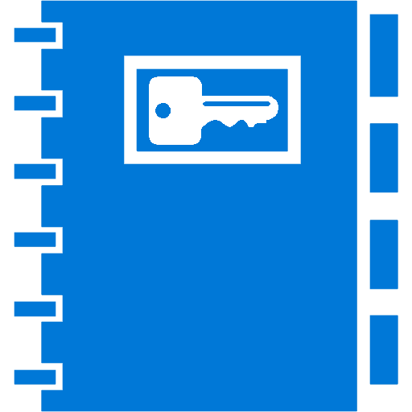



Azure AD Connect
B2B collaboration
Provisioning-Deprovisioning
Conditional Access
SSO to SaaS
Self-Service capabilities
Connect Health
Multi-Factor Authentication
Addition of custom cloud apps
Access Panel/MyApps
Dynamic Groups
Identity Protection
Remote Access to on-premises apps
Azure AD B2C
Group-Based Licensing
Privileged Identity Management
Azure Active Directory
I want to provide my employees secure and easy access to every application from any location and any device
I need my customers, partners, and users to access the apps they need from everywhere and collaborate seamlessly
I want to quickly deploy applications to devices, do more with less and automate Join/Move/Leave processes
[dev use case]
I want to protect access to my resources from advanced threats
I need to comply with industry regulation and national data protection laws
Microsoft Authenticator - Password-less Access
Azure AD Join
MDM-auto enrollment /
Enterprise State Roaming
Security Reporting
Azure AD DS
Office 365 App Launcher
HR App Integration
Access Reviews
aka.ms/Azure/AD/Limits
Notes:
See also https://aka.ms/Azure/AD
Your organization can use Azure AD to improve employee productivity, streamline IT processes, improve security and cut costs in many ways:+
Quickly adopt cloud services, providing employees and partners with an easy single-sign on experience powered by Azure AD’s fully automated SaaS app access management and provisioning services capabilities
Empower employees with access to world-class cloud apps and self-service capabilities from wherever they need to work on the devices they love to use
Easily and securely manage employee and vendor access to your corporate social media accounts
Improve application security with Azure AD multifactor authentication and conditional access
Implement consistent, self-service application access management, empowering business owners to move quickly while cutting IT costs and overheads
Monitor application usage and protect your business from advanced threats with security reporting and monitoring
Secure mobile (remote) access to on-premises applications
Azure AD service limits and restrictions
Review this doc https://docs.microsoft.com/en-us/azure/active-directory/active-directory-service-limits-restrictions
Usually these limits are not constraining for most organizations

Slide 7
How Microsoft Guards Azure AD
https://blogs.technet.microsoft.com/enterprisemobility/2017/09/05/how-we-secure-your-data-in-azure-ad/
3. Bitlocker encrypted servers
4. Just In Time operator access
5. Operators must use Privileged Access Workstation and smartcard
2. Locked cage with 24/7 camera monitoring
7. TLS protected channel and token-based authentication required
1. Controlled datacenter access
6. Active threat monitoring

Slide 8
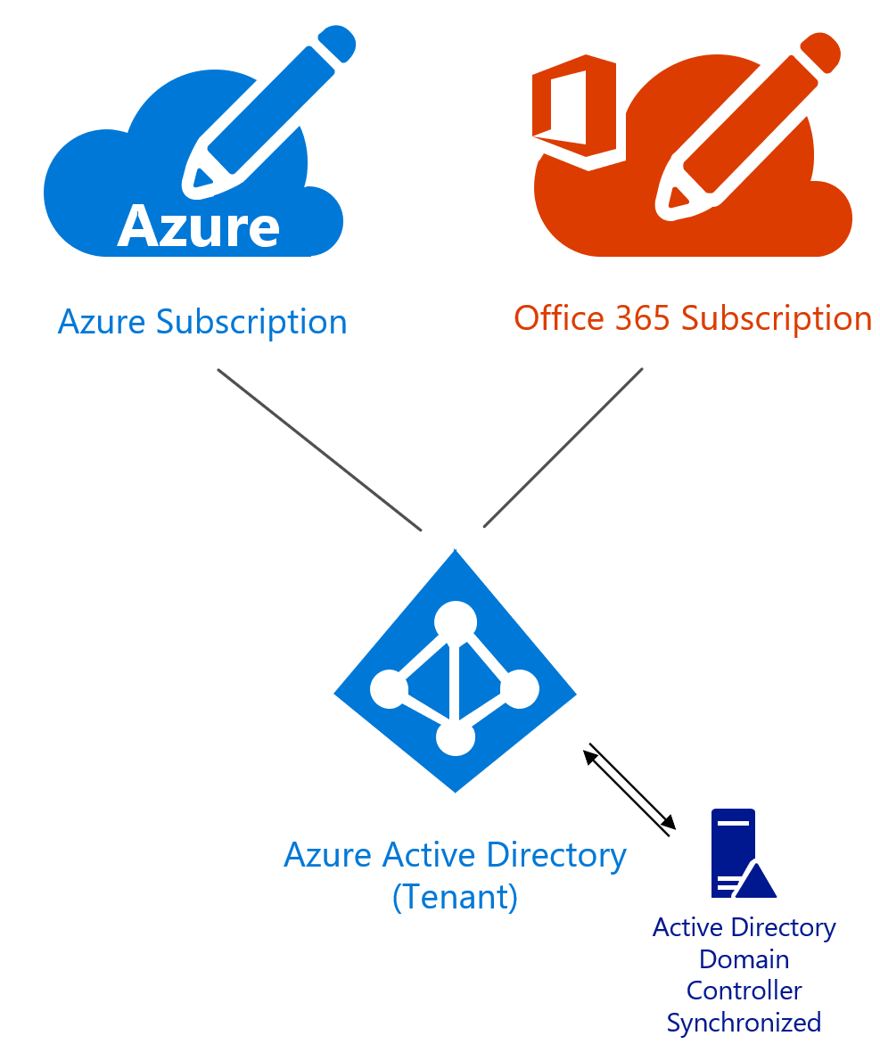
Azure AD tenant
A Tenant is simply a dedicated instance of Azure Active Directory (Azure AD)
A Tenant is associated with a Microsoft service, such as the Azure Portal, 365, and Microsoft Online Service to allow access to users
An Azure Subscription can have multiple Tenants. Each Tenant is separate and unique.
Only one can be Primary
Best practice to have one Tenant common
Although often may match to multiple pre-production environments or Business Units/Customers e.g. Dev, Test, QA, Prod
aka.ms/Azure/Tenant
Notes:
The existence of an Azure AD directory is a requirement for an Azure subscription
The main reason why a customer may have multiple tenants would be that they match to multiple pre-production environments e.g. Dev, Test, QA, Prod
Sometimes customers come in with AD Forests that match these. In these cases it may be good to continue this pattern with parallel tests for Dev, Test, QA, Prod. But the ideal situation is to head towards domain consolidation. But even with multiple domains, it is possible to sync those into one tenant. See Azure AD Connect section and the topologies.

Slide 9
A Big Question
Should I parent my subscriptions to an Azure AD tenant managed by central IT…
… or should I isolate my environment from IT and parent my subscriptions to my own Azure AD?
Answer: either is sufficient if identity lifecycle and tenant policy is being proactively managed, for example accounts are disabled or removed when people leave organization

Slide 10
Azure Active Directory editions
Common features | Basic only | Premium P1 | Premium P2
Directory objects | Group-based access management/provisioning | Self-service group and app management/self-service application additions/Dynamic Groups | Identity protection
User/group management (add/update/delete)/user-based provisioning, device registration | Self-service password reset for cloud users | Self-service password reset/change/unlock with on-premises write-back | Privileged Identity Management
Single sign-on (SSO) | Company branding (logon pages/access panel customization) | Multi-factor authentication (cloud and on-premises (MFA Server))
Self-service password change for cloud users | Application proxy | MIM CAL + MIM Server
Connect (sync engine that extends on-premises directories to Azure Active Directory) | SLA 99.9% | Cloud App Discovery
Security/usage reports |  | Connect Health
 |  | Automatic password rollover for group accounts
Notes:
Self-service password reset
Users can reset their forgotten passwords in Azure AD and the new password can optionally be written back to the on-premises Active Directory
Self Service Group Management
Self-Service Group Management (SSGM) comprises two scenarios: Delegated Group Management and Self-Service Group Management

Slide 11
Azure AD license management
All users that have a Basic, Premium, or EMS license must be specifically assigned to the license in order to use the associated features
There are two ways to associate a license with a user in Azure AD:
Direct license assignment
Licenses are assigned to an individual person
If you are using an Identity Management service in your on-premises environment you can directly assign licenses to users by having the Identity Management service run a PowerShell command
Group membership
Another approach for assigning licenses to Azure AD users is to add the user to an Azure AD group, and then assign the license to the group instead of individual users
aka.ms/azure/ad/licensing
Notes:
Assigning licenses
While obtaining a subscription is all you need to configure paid capabilities, using your Azure AD paid features requires distributing licenses to the right individuals. In general, any user who should have access to or who is managed through an Azure AD paid feature must be assigned a license. A license assignment is a mapping between a user and a purchased service, such as Azure AD Premium, Basic, or Enterprise Mobility Suite.
Managing which users in your directory should have a license is simple. It can be accomplished by assigning to a group to create assignment rules through the Azure AD administration portal or by assigning licenses directly to the right individuals through a portal, PowerShell, or APIs. When assigning licenses to a group, all group members will be assigned a license. If users are added or removed from the group they will be assigned or removed the appropriate license. Group assignment can utilize any group management available to you and is consistent with group-based assignment to applications. Using this approach, you can set up rules such that all users in your directory are automatically assigned, ensure that everyone with the appropriate job title has a license or even delegate the decision to other managers in the organization.
With group-based license assignment, any user missing a usage location will inherit the directory location during assignment. This location can be changed by the administrator at any time. In cases where the automated assignment failed due to error, the user information under that license type will reflect that state.

Slide 12

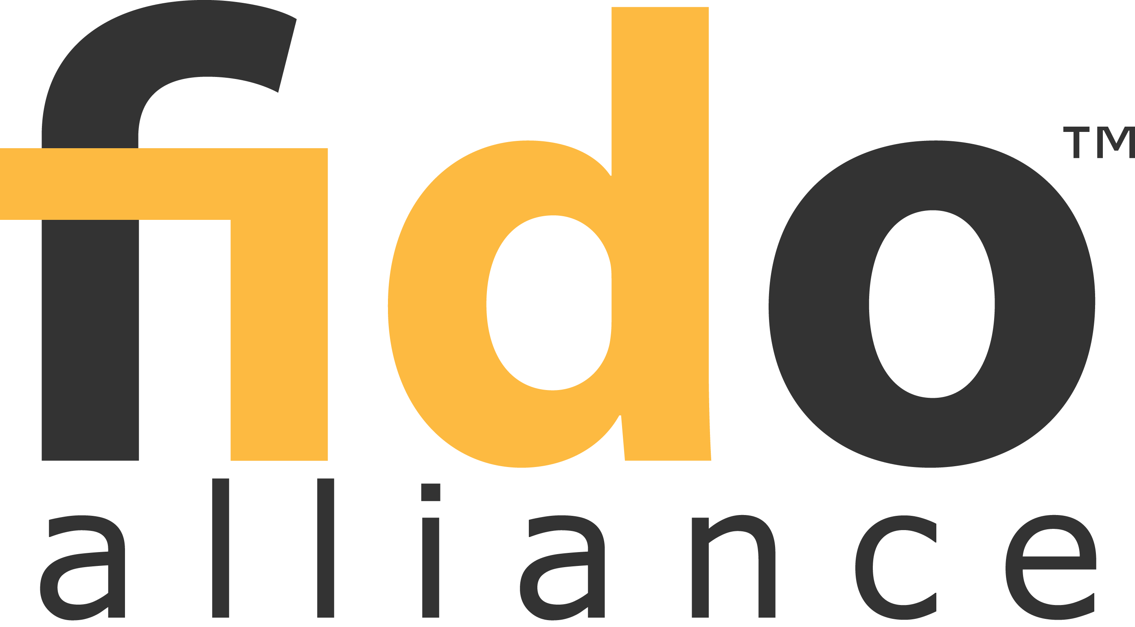
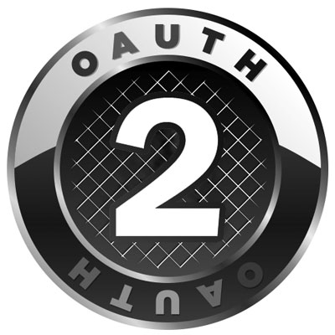
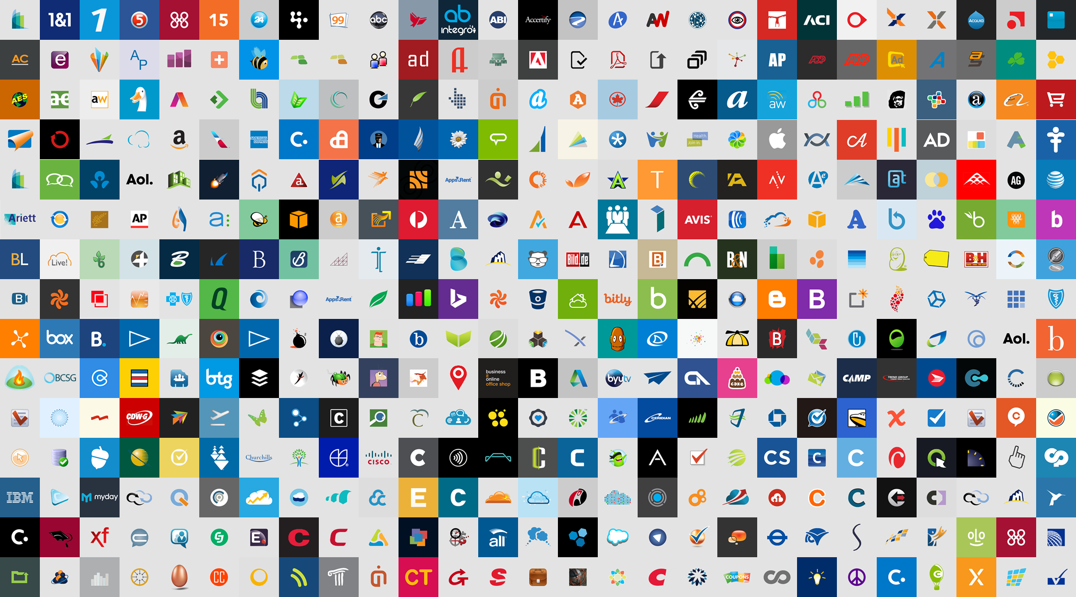

Cross-Platform APIs for Identity Management
OData
SAML 2.0
Microsoft Azure Active Directory
2.0
Token Binding
{ JSON }
“Identity Fabric”
Supports consistent identity protocols across on-premises and cloud
Identity provider supports apps that run on-premises or in any cloud
Open-source authentication libraries:
.NET, iOS, Android, and JavaScript
Enterprise, Consumer apps
Access Libraries
MSAL
ADAL
aka.ms/Azure/Authentication aka.ms/Azure/Protocols

Slide 13
Growing list of sign on methods to Azure AD
Cloud only accounts
Simplest, great for testing or pilot
Password hash sync
Most common recommendation for organizations who want to use on prem identities in the cloud
Federated sign on with AD FS
Keeps passwords on prem and the identity provider under the organization’s control; with audit trail on prem; plus third party interoperability
Newest: Pass through authentication and Desktop SSO (PTA/SSO)
Competitive, simplicity and light footprint – in preview now
Notes:
Everything after Cloud only accounts we have complete sections on each. Just briefly go over this.

Slide 14
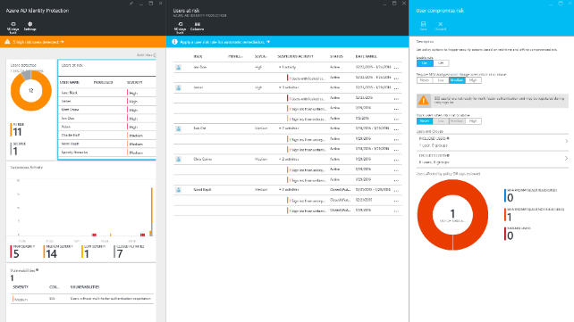
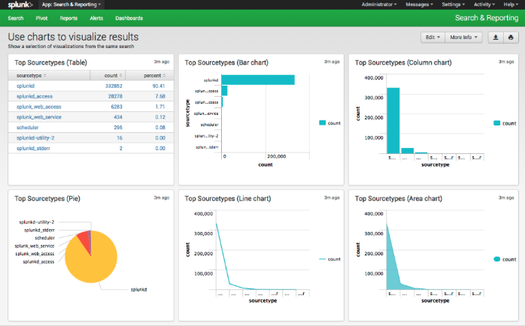
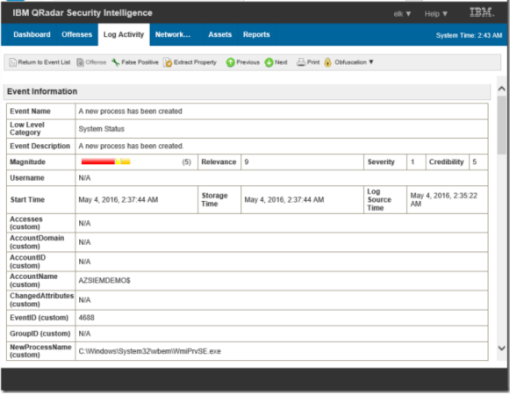
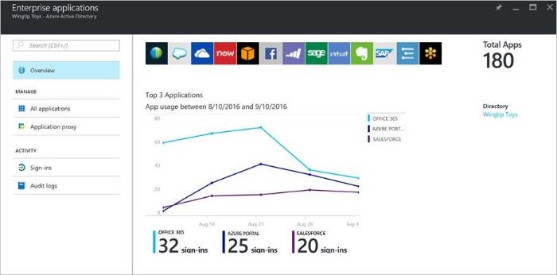
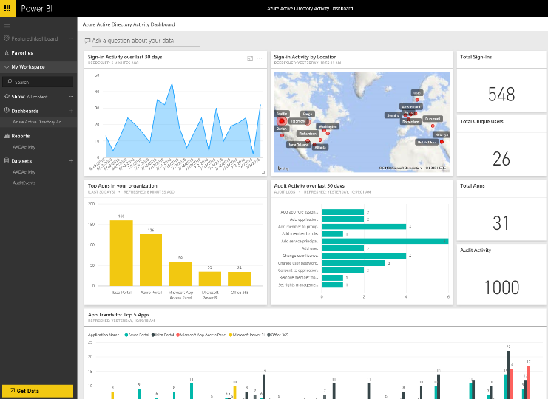
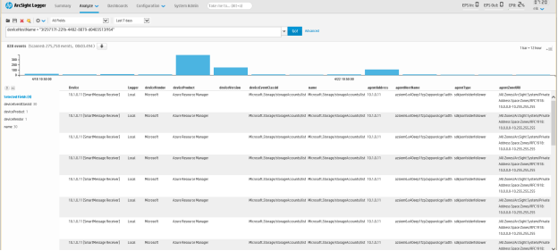
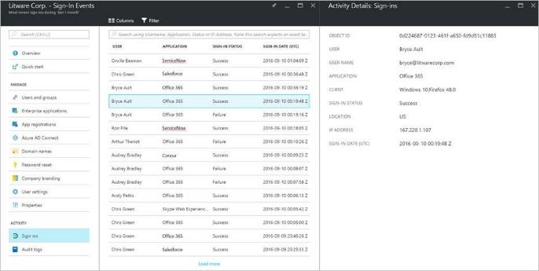
Scale your data and reporting
Combine the power of Azure AD with your PowerBI, SIEM, and other monitoring tools
QRadar
Splunk
Notifications
Data extracts/
downloads
Power BI
ArcSight
Reporting APIs
Azure AD
Notes:
Azure Active Directory provides you with a variety of reports. The data of these reports can be very useful to your applications, such as SIEM systems, audit, and business intelligence tools. The Azure AD reporting APIs provide programmatic access to the data through a set of REST-based APIs. You can call these APIs from a variety of programming languages and tools.
Azure AD audit and reporting
One-click audit & compliance through portal.azure.com
Forensics and investigation: Help admins answer: “who did what, where, and when”
Activity reports: Audit, sign ins, SSPR, group activity, app activity, app provisioning, etc.
Security reports: Provides rich mitigation and resolution for security anomalies through Identity protection
Azure Active Directory Reporting Guide
https://docs.microsoft.com/en-us/azure/active-directory/active-directory-reporting-guide for reference

Slide 15
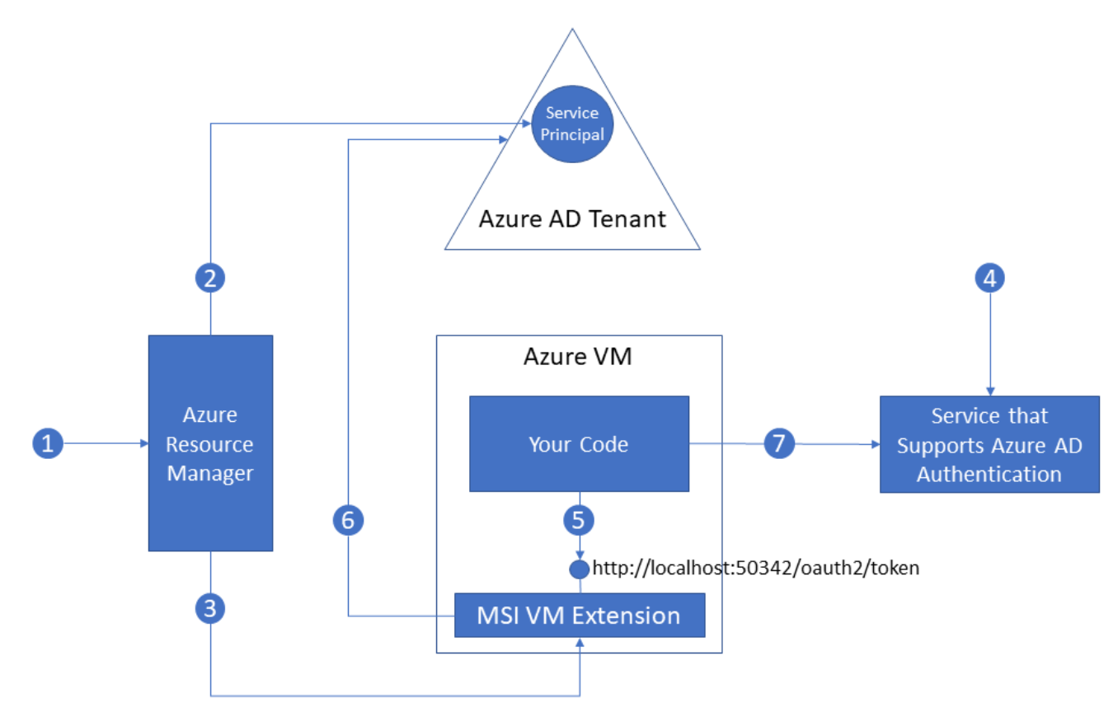
Managed Service Identity (preview as of Dec 2017)
The Challenge
Applications need secure access to credentials
How to manage them without going into KeyVault
Solution
A managed identity in Azure AD for Azure Services
Authenticate to any service that supports Azure AD Authentication
No credentials in code required and its FREE
How it works
Credentials automatically rolled
If service is deleted, so are credentials
Supported services (as of Dec 2017)
VMs, App Service, Azure Functions
aka.ms/Azure/MSI
Notes:
A common challenge when building cloud applications is how to manage the credentials that need to be in your code for authenticating to cloud services. Keeping these credentials secure is an important task. Ideally, they never appear on developer workstations or get checked into source control. Azure Key Vault provides a way to securely store credentials and other keys and secrets, but your code needs to authenticate to Key Vault to retrieve them. Managed Service Identity (MSI) makes solving this problem simpler by giving Azure services an automatically managed identity in Azure Active Directory (Azure AD). You can use this identity to authenticate to any service that supports Azure AD authentication, including Key Vault, without having any credentials in your code.
EXAMPLE IN PICTURE
Azure Resource Manager receives a message to enable MSI on a VM.
Azure Resource Manager creates a Service Principal in Azure AD to represent the identity of the VM. The Service Principal is created in the Azure AD tenant that is trusted by this subscription.
Azure Resource Manager configures the Service Principal details in the MSI VM Extension of the VM. This step includes configuring client ID and certificate used by the extension to get access tokens from Azure AD.
Now that the Service Principal identity of the VM is known, it can be granted access to Azure resources. For example, if your code needs to call Azure Resource Manager, then you would assign the VM’s Service Principal the appropriate role using Role-Based Access Control (RBAC) in Azure AD. If your code needs to call Key Vault, then you would grant your code access to the specific secret or key in Key Vault.
Your code running on the VM requests a token from a local endpoint that is hosted by the MSI VM extension: http://localhost:50342/oauth2/token. The resource parameter specifies the service to which the token is sent. For example, if you want your code to authenticate to Azure Resource Manager, you would use resource=https://management.azure.com/.
The MSI VM Extension uses its configured client ID and certificate to request an access token from Azure AD. Azure AD returns a JSON Web Token (JWT) access token.
Your code sends the access token on a call to a service that supports Azure AD authentication.
Each Azure service that supports Managed Service Identity has its own method for your code to obtain an access token.

Slide 16
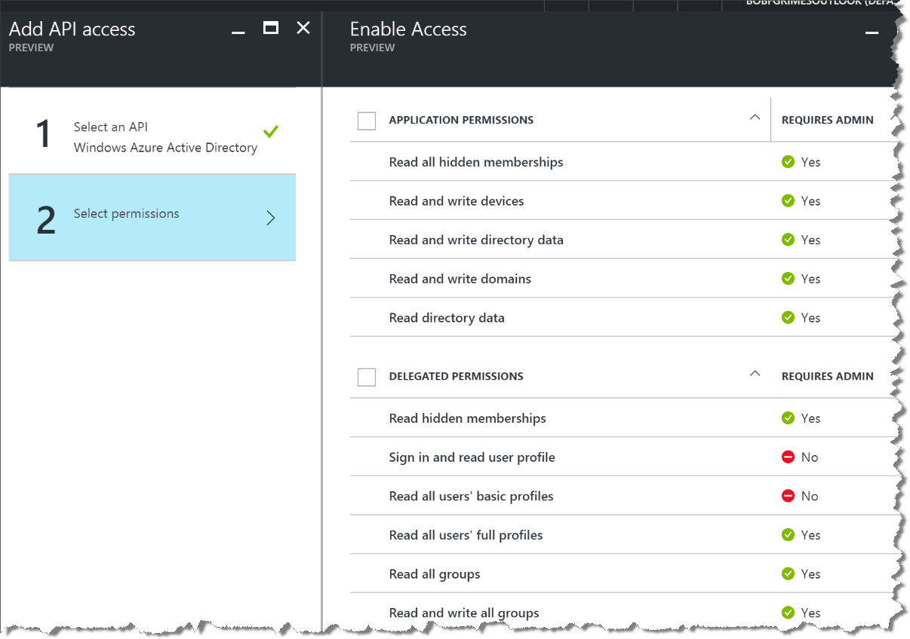
Graph API
RESTful API
Create, read, search, update, and delete local accounts
OData 3.0 compliant service
Use cases
Migration
Profile lookup and update
Call center/back office apps
User object model
userPrincipalName
signInNames
creationType
passwordPolicies linkedAccount: Facebook, Facebook UserID
OtherMails
Custom attributes, etc
aka.ms/Azure/GraphAPI
https://resources.azure.com/
Notes:
The Graph API exposes OAuth 2.0 permission scopes that are used to control access that an app has to customer directory data. As a developer, you configure your app with the permission scopes appropriate to the access that it requires. Typically you do this through the Azure portal. During sign-in, users or administrators are given an opportunity to consent to allow your app access to their directory data with the permission scopes you configured. For this reason, you should choose permission scopes that provide the least level of privilege needed by your app.

Slide 17
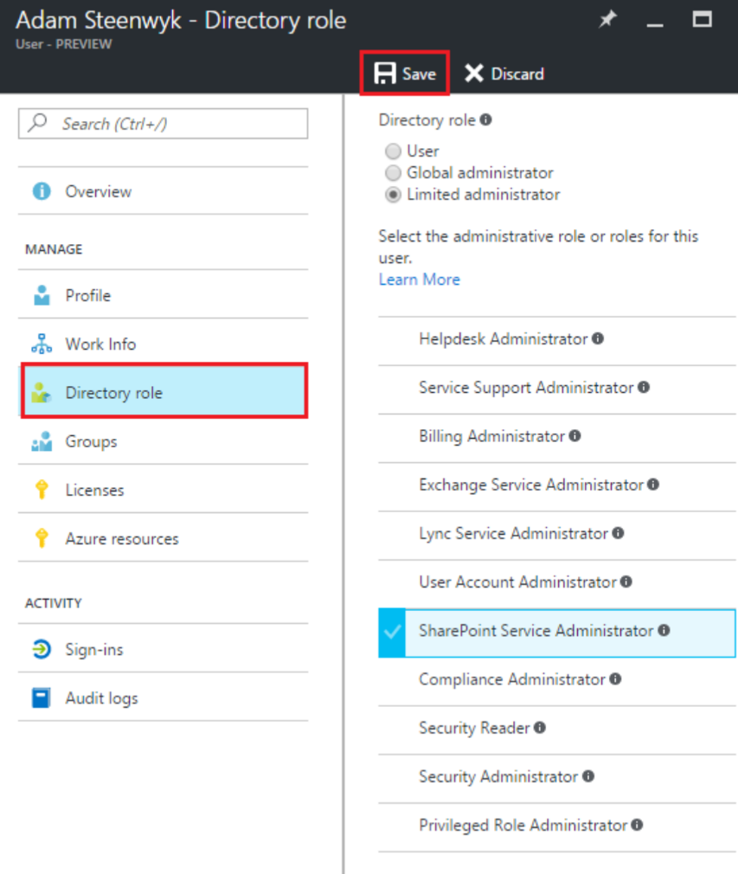
Administration
Enterprise Agreement (EA)
Enterprise, Department Administrators
Account Owner and Service Administrator
Azure Active Directory
User
Global Administrator
Limited administrator read more
Role Based Access Control
Owner, Contributor, Reader
Built-in or Custom Roles
Scope | Subscription, Resource Group or resource
Active Directory
Use synched or federated users/groups
aka.ms/Azure/Administration aka.ms/Azure/RBAC
Notes:
This is important to make sure the customer understands all the different planes of administration that are possible, and how the work together or not. There will be more on RBAC in the Security SAW. The key point here to note is there are multiple layers of administration and it is important to know who can do what and where.
Azure RBAC vs. classic subscription administrators – NOTE – since classic is being deprecated DO NOT USE Co-Administrator accounts any more
Classic subscription administrators and co-admins have full access to the Azure subscription. They can manage resources using the Azure portal with Azure Resource Manager APIs, or the Azure classic portal and Azure classic deployment model. In the RBAC model, classic administrators are assigned the Owner role at the subscription scope.+
Only the Azure portal and the new Azure Resource Manager APIs support Azure RBAC. Users and applications that are assigned RBAC roles cannot use the classic management portal and the Azure classic deployment model.
ENTERPRISE AGREEMET ROLES
Enterprise Administrator - Has the rights to add additional Enterprise Administrators, Department Administrators, Departments and even associate accounts to the enrollment. An Enterprise Administrator can view usage and charges across all accounts and subscriptions.
Department Administrator - Can edit their assigned department details such as name and cost center, manage the department administrators and create accounts under the department within the enrollment and view department charges (if allowed by the Enterprise Administrator).
Account Owner - Can create subscriptions under the account and manage the subscriptions Service Administrator and Co-Administrators. Usage data for the account can be viewed and charges (if enabled by the Enterprise Administrator).
Service Administrator - Access and manage subscriptions they are assigned to.

Slide 18
Best Practices for Locking Down Access
Make sure people automatically lose access when they leave
Use multi-factor authentication for all Azure users
Today’s #1 cyber weapon: good grammar
Use “break glass” accounts for Account & Service Admins
Give people minimum access needed for day to day work – RBAC and Azure Privileged Identity Management (PIM)
Use Managed Service Identity to keep credentials out of code
Notes:
We’ll talk about MSI in a slide later

Slide 19
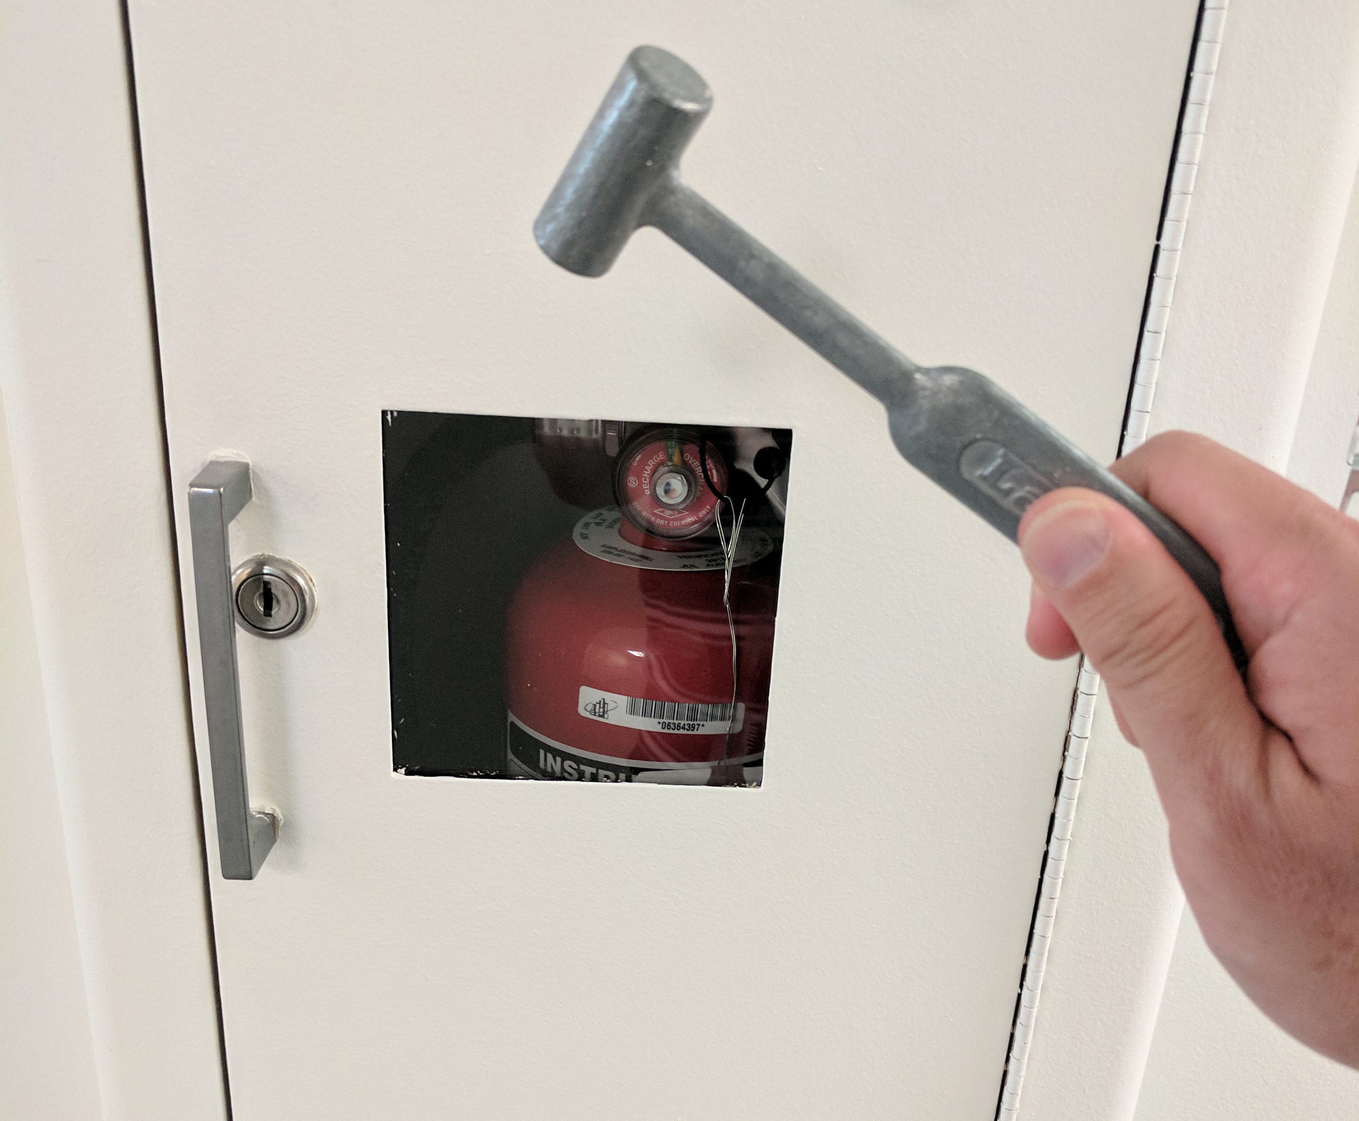
Use “Break Glass” Accounts
Do not use account for daily work
Write down strong random password and lock it away
Do not share password
Change password every time you use it and on scheduled basis
Enable per-user MFA

Slide 20

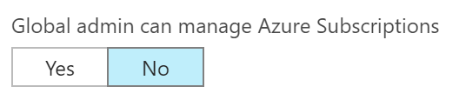
Azure RBAC versus Azure AD RBAC
Several roles span Azure AD and Office 365, for example:
Global admin
User admin
Azure AD
By default, roles do not span Azure AD and Azure. Azure AD Global admin has no default access* to Azure subscriptions
* Except if https://portal.azure.com
→ Azure AD → Properties
Azure
Office 365
Notes:
NOTE
This will become more important to note when talking about traditional Azure PIM versus the newer Azure PIM for Resources. The former ONLY deals with Azure AD RBAC i.e. only Azure AD admin roles. The latter PIM for resources does just in time(JIT) and Just Enough Access (JEA) for Azure resources and the related RBAC roles. These are two different administration planes and companies need to understand the differences in particular around adhering to “Least Privilege” and “Separation of Duties”
PIM is discussed later in the deck.

Slide 21
Best Practice: Manage to Least Privilege
More actions
More scope
 | Reader | Resource-specific or Custom role | Contributor | Owner
Subscription
Resource Group
Resource
“Blast radius”

Slide 22
Best Practice: Manage to Least Privilege
 | Reader | Resource-specific or Custom role | Contributor | Owner
Subscription
Resource Group
Resource
Observers
People doing real work
Use “break glass” account
Single-purpose robots or targeted debug
“Use minimum role assignments to get normal work done.”

Slide 23
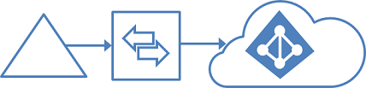
Azure AD Connect
Notes:
Azure AD provides the core directory and identity management capabilities behind most of Microsoft’s cloud services, including:
Azure Subscription
Microsoft Office 365
Microsoft Dynamics CRM Online
Microsoft Intune
You will get an Azure AD directory when you sign up for any of these Microsoft cloud services. You can create additional directories as needed. For example, you might maintain your first directory as a production directory and then create another directory for testing or staging.

Slide 24
Azure Active Directory Connect
Primary tool to onboard to Azure AD
Express settings gets customers connected in a matter of minutes
Provides install & configuration of password sync/ADFS for sign-in
All future investments will only be available with Azure AD Connect
Azure AD Connect
DirSync
Azure AD Sync
Sync
FIM + Azure AD Connector
ADFS
Health
ADFS
Notes:
Sync tools Include:
Azure AD Connect: Simple scenarios
MM and the Azure AD Connector: Complex scenarios
Previous Sync Tools: AAD Sync and DirSync – OLD – do not use anymore
Consolidated deployment assistant for your identity bridge components
All currently available sync engines will be replaced by the Sync engine included in the Connect tool
Assisted deployment of ADFS will be available through Azure Active Directory Connect
Authenticating to Azure AD
Enable password hash synchronization so that the Azure AD password for users is the same as the on-premises AD password
Otherwise, users will have different passwords for AD and Azure AD
Authenticating to an On-premises identity provider
Azure AD supports the ability to establish an identity federation trust with an on-premises Identity Provider (IdP), such as Active Directory Federation Services (AD FS)
This enables users to have a desktop single sign-on experience when accessing resources that are integrated with Azure AD

Slide 25
Azure AD UPN alignment
The UPN (User Principal Name) is the attribute in Azure AD that is used for a user’s sign-in name.
By default, this is sourced from the on-premises Active Directory using the userPrincipalName attribute on the user account.
Azure AD requires that the UPN suffix be a valid public domain name that is registered with an Internet name registrar.
Customers that have a UPN suffix that is not routable or not desirable for the user logon name have two options:
Perform a UPN rationalization exercise i.e. you want UPN suffix to match on-premises with Azure AD
Use the Alternate Login ID.
Generally NOT recommended
Alternate ID is not compatible with all O365 workloads
Read more
Notes:
Selecting the attribute for the user principal name in Azure AD
The attribute userPrincipalName is the attribute that users use when they sign in to Azure AD and Office 365. You should verify the domains (also known as UPN suffixes) that are used in Azure AD before the users are synchronized.
We strongly recommend that you keep the default attribute userPrincipalName. If this attribute is nonroutable and can't be verified, then it's possible to select another attribute (email, for example) as the attribute that holds the sign-in ID. This is known as the Alternate ID. The Alternate ID attribute value must follow the RFC 822 standard. You can use an Alternate ID with both password SSO and federation SSO as the sign-in solution.

Slide 26
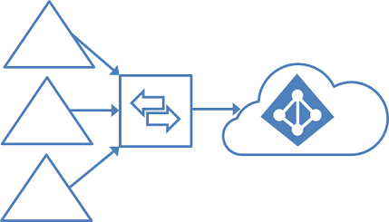
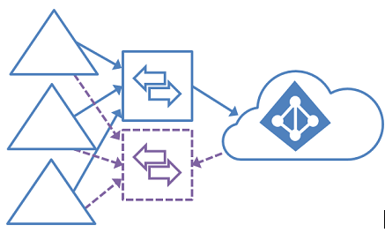
Supported Topologies
Active Directory Forests
Single or multiple?
Single or multiple domains?
Azure AD Tenants
Single or Multiple exist?
How many planned?
Office 365 Considerations
Exchange Online?
Skype for Business? Read more for either
Staging Server
Does READS, no WRITES on a 2nd server
Use for failover, for testing or to replace a server
Can have more than 1 staging server
Read more
Notes:
NOTE: the double arrow object represents a SYNC server. The purple one is the staging server.
At this point if it hasn’t been discussed, find out what type of synchronization is in place or not? Ask Questions about their current AD environment. Find out what they have by asking these questions. There is a slide at the end to confirm these questions also.
We recommend having a single tenant in Azure AD for an organization. Before you plan to use multiple Azure AD tenants, see the article Administrative units management in Azure AD. It covers common scenarios where you can use a single tenant.
Be sure to review https://docs.microsoft.com/en-us/azure/active-directory/connect/active-directory-aadconnect-topologies and even pull it up or share if needed.
These tasks are unsupported:
Sync the same user to multiple Azure AD tenants.
Make a configuration change so that users in one Azure AD tenant appear as contacts in another Azure AD tenant.
Modify Azure AD Connect sync to connect to multiple Azure AD tenants.

Slide 27
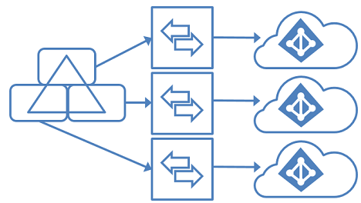
Filter mutually exclusive AD Objects per tenant
Active Directory Forests
Only one in this scenario
But different parts synchronized to different…
Azure AD Tenants
Multiple
Could map to diff business units
Or Prod, Dev, Test, QA users within the Domain
DNS Domain
Only 1 per tenant allowed
Therefore need multiple UPNs for users in Domain
No GAL Sync between Azure AD Tenants
Additional Restrictions apply –see article
Notes:
This is for reference and in case this option comes up. This is a new scenario and an exception. It is the only 1:many, but still requires multiple sync servers, but each one filters a different part of the single Active Directory domain, to different tenants. An example would be where an org could have Organizational Units (OU)s by businesses or pre-production environments….and they want them to each have ownership of their own Azure AD tenant and corresponding Azure Subscription.
This is rare and should be reviewed in depth on the see article link! One real world use case was a government agency that wanted to have their on-premises directory to be split between Azure Commercial and Azure Government. This scenario solved that problem.
This topology has the following restrictions on otherwise supported scenarios:
Only one of the Azure AD tenants can enable an Exchange hybrid with the on-premises Active Directory instance.
Windows 10 devices can be associated with only one Azure AD tenant.
The single sign-on (SSO) option for password synchronization and pass-through authentication can be used with only one Azure AD tenant.
The requirement for a mutually exclusive set of objects also applies to writeback. Some writeback features are not supported with this topology because they assume a single on-premises configuration. These features include:
Group writeback with default configuration.
Device writeback.

Slide 28
Azure AD Connect and Windows 10 devices
Forward sync
Syncs domain DNS name and samaccountname of users to support SSO to Kerb apps from Azure AD joined devices
Syncs Computer Accounts for enhanced Domain Join functionality. Requires certificate attribute on computer account is populated
Handled by default and no additional configuration required
Writeback
Microsoft Passport Credentials for login to AD DS and ADFS in WS2016 (TP4 or higher)
Notes:
If Windows 10 is not in use, skip this or brief over the capabilities. This is usually not part of the scope of an HCF, but the purpose is to inform of current capabilities.

Slide 29
Azure AD Connect and Writeback
Password Writeback
Pairs with one of the most popular features of Azure AD Premium (SSPR)
Ability to reset passwords on-prem (password sync and federation supported)
Group Writeback
Office 365 groups written back as DGs
Improves productivity in hybrid scenarios
Device Writeback
Supports ability to do conditional access in ADFS based on registered devices
Exchange Hybrid Writeback
Notes:
Azure AD Premium required. Mainly information to share if they already have O365 running, or else it is a parallel effort in motion.

Slide 30
Federation
Notes:
Azure AD provides the core directory and identity management capabilities behind most of Microsoft’s cloud services, including:
Azure Subscription
Microsoft Office 365
Microsoft Dynamics CRM Online
Microsoft Intune
You will get an Azure AD directory when you sign up for any of these Microsoft cloud services. You can create additional directories as needed. For example, you might maintain your first directory as a production directory and then create another directory for testing or staging.

Slide 31
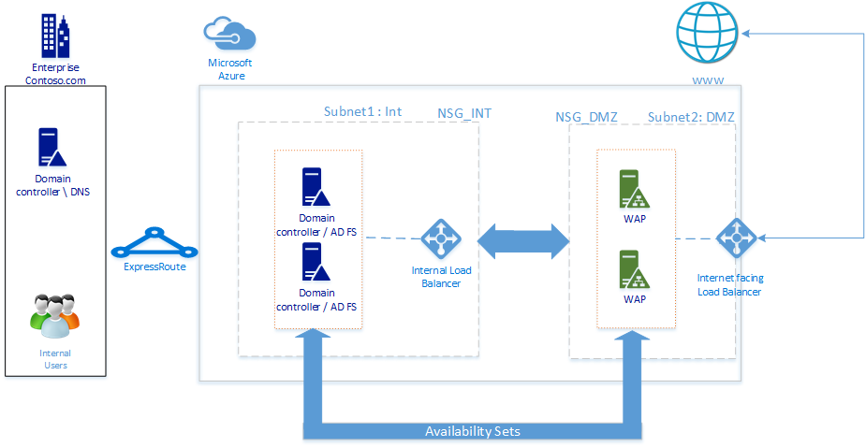
Federation
Use federation if:
Single sign-on is required
AD FS is already deployed
You use a third-party identity provider
You use Forefront Identity Manager 2010 R2 (does not support password hash synchronization)
You have an on-premises integrated smart card or other MFA solution
You require sign-in audit and/or disablement of accounts
Your organization requires client sign-in restrictions by network location or work hours
Compliance with Federal Information Processing Standards (FIPS)
Requires infrastructure:
Can be virtualized
Can be in Azure IaaS
Example deployment in Azure…
aka.ms/ADFSLinks
Notes:
CONSULTANCY NOTE: At this point if not already known, there should be discovery about what and if Federation exists currently? Are they using AD FS? If so what versions? Looking to upgrade to AD FS 2016? Using 3rd party Federation?
Provides the following capabilities:
All authentication to Azure AD is performed against the on-premises directory via Active Directory Federation Services (AD FS) or another federated identity provider.
Works with non-Microsoft identity providers.
Password hash sync adds the capability to act as a sign-in backup for federated sign-in (if the federation solution fails).

Slide 32
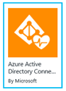
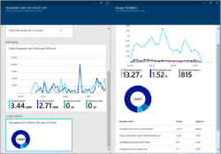

Monitor your Identity Bridge
Azure AD Connect Health
Monitor and gain insights into the identity infrastructure used to extend on-premises identities to Azure Active Directory and Office 365.
The Azure AD Connect sync engine health
Active Directory Federation Server (ADFS) infrastructure health
Corporate network
On-premises Active Directory Domain Services health
aka.ms/azure/ConnectHealth
ADFS
Notes:
The Azure AD Connect Health service allows you to install agents on your AD FS servers that push audit data into Azure AD.
Single lens into “identity” monitoring
Monitoring for ADFS and Sync and new AD DS
103K Active Azure AD Connect servers are sending data to Azure AD Connect Health service. This service can scale!
A low noise alerting system with helpful troubleshooting information
Reports and operational insights about usage trends
An easy-to-onboard, robust, and scalable cloud service
Agent Installation
Install agent on each monitored AD FS server
Enable Auditing for the Usage Analytics in AAD Connect Health to work properly.
Ensure that outbound URLs that the agent contacts are not blocked by firewalls
Network Connectivity
The AAD Connect Health agent will send audit and event log data to Azure AD.
If connectivity isn’t restored before the queue is full, the newer data will overwrite the older data until network connectivity is restored.
Ensure that there’s a big enough buffer on the AD FS Audit channel to prevent the wrapping of data.

Slide 33

Use identities from an LDAP directory
Configure both sync and sign-on
Supports any LDAP v3 directory
Un-trusted forests
DMZ forests
3rd party directories
Can support multiple LDAP directories
Available today
Windows Server 2016
Configure ADFS for LDAP
Azure AD
SaaS
Azure
Partner
Resources
Office 365
LOB Apps
ADFS
LDAP Directories
ADDS

Slide 34
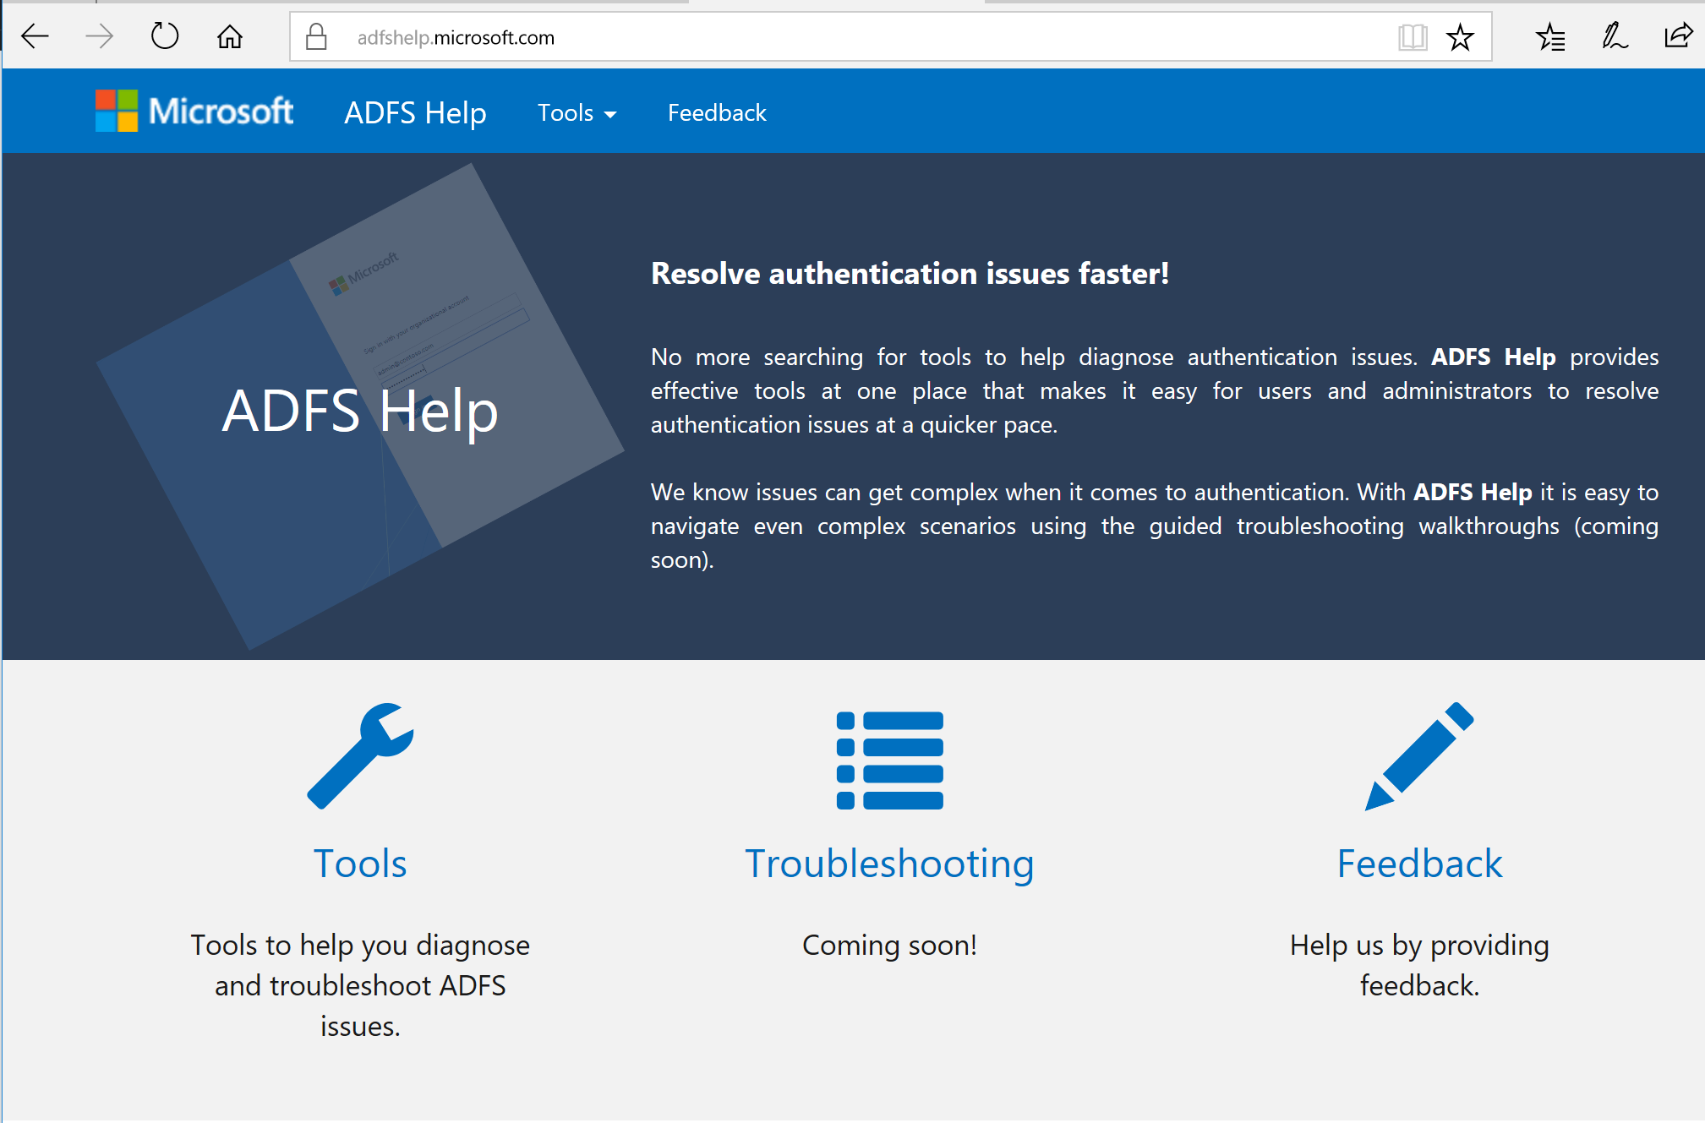
AD FS Help
https://aka.ms/adfshelp
One stop for resolving your federation issues
Visit today to try available tools to help you diagnose and troubleshoot AD FS issues
Notes:
Make sure to understand when and why this would/could be used. Make sure to read and know https://docs.microsoft.com/en-us/azure/active-directory/connect/active-directory-aadconnect-pass-through-authentication

Slide 35
Pass-Through Authentication (PTA) Identity synchronization + Pass-through authentication with Seamless SSO
Microsoft Azure Active Directory
Office 365, SaaS, and LoB apps
Identity synchronization using Azure AD Connect
Pass-through authentication
Password validation requests are sent to Windows Server Active Directory via Pass-through authentication
Pass-through authentication agent
On- premises
aka.ms/Identity/PTA
Notes:
Make sure to understand when and why this would/could be used. Make sure to read and know https://docs.microsoft.com/en-us/azure/active-directory/connect/active-directory-aadconnect-pass-through-authentication
http://aka.ms/Identity/PTA

Slide 36
What AD FS offers that PTA with SSO doesn’t
Support for smartcard authentication
Support for 3rd Party MFA providers
Passwords are always in your control boundary – i.e. don’t pass through the cloud
On-premises conditional access rules based on issuance policies, such as
Exchange protocols (e.g. pop, imap etc)
Inside network claim

Slide 37
Azure AD Application Proxy
Microsoft Azure
Active Directory
Application
Proxy
Notes:
Azure AD provides the core directory and identity management capabilities behind most of Microsoft’s cloud services, including:
Azure Subscription
Microsoft Office 365
Microsoft Dynamics CRM Online
Microsoft Intune
You will get an Azure AD directory when you sign up for any of these Microsoft cloud services. You can create additional directories as needed. For example, you might maintain your first directory as a production directory and then create another directory for testing or staging.

Slide 38



Azure Active Directory Application Proxy
Single Sign-on to on-premises applications
Microsoft Azure
Active Directory
Application
Proxy
connector
https://sales.contoso.com/
Azure or 3rd Party IaaS
DMZ
User
connector
connector
connector
https://sales.contoso.com
https://expense
https://travel
https://hrweb
Notes:
Azure AD Application Proxy provides single sign-on (SSO) and secure remote access for web applications hosted on-premises. This can include SharePoint sites, Outlook Web Access, or any other LOB web applications you have. These on-premises web applications are integrated with Azure AD, the same identity and control platform that is used by O365. End users can then access your on-premises applications the same way they access O365 and other SaaS apps integrated with Azure AD. You don't need to change the network infrastructure or require VPN to provide this solution for your users.
Why is Application Proxy a better solution?
Azure AD Application Proxy provides a simple, secure, and cost-effective remote access solution to all your on-premises applications.
Azure AD Application Proxy:
Works in the cloud, so you can save time and money. On-premises solutions require you to set up and maintain DMZs, edge servers, or other complex infrastructures.
Is easier to set up and secure than on-premises solutions because you don't have to open any inbound connections through your firewall.
Offers great security. When you publish your apps using Azure AD Application Proxy, you can take advantage of the rich authorization controls and security analytics in Azure. You get advanced security capabilities for all your existing apps without having to change any app.
Gives your users a consistent authentication experience. Single sign-on gives your end users the ease and simplicity of access to all the apps they need to be productive with one password.
With Azure AD Application Proxy you can access different types of internal applications:+
Web applications that use Integrated Windows Authentication for authentication
Web applications that use form-based access
Web APIs that you want to expose to rich applications on different devices
Applications hosted behind a Remote Desktop Gateway
Application Proxy is a feature that is available only if you upgraded to the Premium or Basic edition of Azure Active Directory.
A connector that auto connects to the cloud service
Multiple connectors can be deployed for redundancy, scale, multiple sites, and different resources
Connectors are deployed usually on corpnet next to resources
Users connect to the cloud service that routs their traffic to the resources via the connectors

Slide 39
Prerequisites for the Azure AD Application Proxy
Requires Azure AD Basic or Premium (P1 or P2) subscription
https://www.microsoft.com/en-us/cloud-platform/azure-active-directory-features
Connector must be installed on
Windows Server 2102 R2 or higher
Windows 8.1 or higher
The on-premises firewall must be enabled for outbound traffic from the connector
You can check the outbound traffic requirements by connecting, via a browser, to http://testport.cloudapp.net/
Download the connector from the Azure Portal when you enable the Application Proxy
Install and register with your Azure AD tenant
A troubleshooter is included as part of the install process

Slide 40

Privileged Identity Management
Notes:
Azure AD provides the core directory and identity management capabilities behind most of Microsoft’s cloud services, including:
Azure Subscription
Microsoft Office 365
Microsoft Dynamics CRM Online
Microsoft Intune
You will get an Azure AD directory when you sign up for any of these Microsoft cloud services. You can create additional directories as needed. For example, you might maintain your first directory as a production directory and then create another directory for testing or staging.

Slide 41
Privileged Identity Management
Discover, restrict, and monitor privileged identities
User
Administrator
Administrator privileges expire after a specified interval
User
Enforce on-demand, just-in-time administrative access when needed
Ensure policies are met with alerts, audit reports and access reviews
Manage admins access in Azure AD and also in Azure RBAC
Notes:
You can assign users in your organization to different administrative roles in Azure AD. These role assignments control which tasks, such as adding or removing users or changing service settings, the users are able to perform on Azure AD, Office 365 and other Microsoft Online Services and connected applications.
Azure AD Privileged Identity Management (PIM) manages policies for privileged access for users in Azure AD. PIM assigns users to one or more roles in Azure AD, and you can assign someone to be permanently in the role, or eligible for the role. When a user is permanently assigned to a role, or activates an eligible role assignment, then they can manage Azure Active Directory, Office 365, and other applications with the permissions assigned to their roles.
Azure AD Privileged Identity Management helps you:
See which users are Azure AD administrators
Enable on-demand, "just in time“ (JIT) and “just enough” (JEA) administrative access
Get reports about administrator access history and changes in administrator assignments
Get alerts about access to a privileged role
Conditional MFA
There's no difference in the access given to someone with a permanent versus an eligible role assignment. The only difference is that some people don't need that access all the time. They are made eligible for the role, and can turn it on and off whenever they need to.
Roles managed in PIM
Privileged Identity Management lets you assign users to common administrator roles, including:
Global administrator (also known as Company administrator) has access to all administrative features. You can have more than one global admin in your organization. The person who signs up to purchase Office 365 automatically becomes a global admin.
Privileged role administrator manages Azure AD PIM and updates role assignments for other users.
Billing administrator makes purchases, manages subscriptions, manages support tickets, and monitors service health.
Password administrator resets passwords, manages service requests, and monitors service health. Password admins are limited to resetting passwords for users.
Service administrator manages service requests and monitors service health.
User management administrator resets passwords, monitors service health, and manages user accounts, user groups, and service requests. The user management admin can’t delete a global admin, create other admin roles, or reset passwords for billing, global, and service admins.
Exchange administrator has administrative access to Exchange Online through the Exchange admin center (EAC), and can perform almost any task in Exchange Online.
SharePoint administrator has administrative access to SharePoint Online through the SharePoint Online admin center, and can perform almost any task in SharePoint Online.
Skype for Business administrator has administrative access to Skype for Business through the Skype for Business admin center, and can perform almost any task in Skype for Business Online.
Note
If you are using Office 365, then before assigning the service admin role to a user, first assign the user administrative permissions to a service, such as Exchange Online.
Roles not managed in PIM
Roles within Exchange Online or SharePoint Online, except for those mentioned above, are not represented in Azure AD and so are not visible in PIM. For more information on changing fine-grained role assignments in these Office 365 services, see Permissions in Office 365.+
Azure subscriptions and resource groups are also not represented in Azure AD. To manage Azure subscriptions, see How to add or change Azure administrator roles and for more information on Azure RBAC see Azure Role-Based Access Control.

Slide 42

Azure PIM dashboard
Azure AD Privileged Identity Manager provides a dashboard that gives you important information such as:
Alerts that point out opportunities to improve security
The number of users who are assigned to each privileged role
The number of eligible and permanent admins
Ongoing access reviews

Slide 43


Azure PIM role management
Manage the administrators by adding or removing permanent or eligible administrators to each role:

Slide 44

Azure PIM role activation history
Track changes in privileged role assignments and role activation history

Slide 45

PIM for Azure Resources (preview)
Discover, restrict, and monitor privileged Azure Roles
Manage Built-In Azure RBAC Roles
Owner
User Access Administrator
Contributor
Security Admin
Security Manager, and more
Notes:
With Azure Active Directory Privileged Identity Management (PIM), you can now manage, control, and monitor access to Azure Resources (Preview) within your organization. This includes Subscriptions, Resource Groups, and even Virtual Machines. Any resource within the Azure portal that leverages the Azure Role Based Access Control (RBAC) functionality can take advantage of all the great security and lifecycle management capabilities Azure AD PIM has to offer, and some great new features we plan to bring to Azure AD roles soon.

Slide 46

Azure AD Identity Protection

Slide 47


Azure Active Directory Identity Protection
Security service that provides a consolidated view into risk events and potential vulnerabilities affecting your organization’s identities. This service is based on an adaptive machine learning algorithms and heuristics to detect anomalies and risk events that may indicate that an identity has been compromised
Gain insights from a consolidated view of machine learning based threat detection
Remediation recommendations
Risk severity calculation
Risk-based conditional access automatically protects against suspicious logins and compromised credentials
Configuration vulnerabilities
Leaked credentials
Infected devices
Risk-based policies
Brute force attacks
Suspicious sign-in activities
MFA challenge risky logins
Machine-Learning Engine
Change bad credentials
Block attacks
aka.ms/azure/aadip
Notes:
With Azure Active Directory Identity Protection, in your environment, you can use the same protection systems Microsoft uses to secure identities.
The vast majority of security breaches take place when attackers gain access to an environment by stealing a user’s identity. Over the years, attackers have become increasingly effective in leveraging third party breaches and using sophisticated phishing attacks. As soon as an attacker gains access to even low privileged user accounts, it is relatively easy for them to gain access to important company resources through lateral movement.
As a consequence of this, you need to:
Protect all identities regardless of their privilege level
Proactively prevent compromised identities from being abused
Discovering compromised identities is no easy task. Azure Active Directory uses adaptive machine learning algorithms and heuristics to detect anomalies and suspicious incidents that indicate potentially compromised identities. Using this data, Identity Protection generates reports and alerts that enable you to evaluate the detected issues and take appropriate mitigation or remediation actions.+
Azure Active Directory Identity Protection is more than a monitoring and reporting tool. To protect your organization's identities, you can configure risk-based policies that automatically respond to detected issues when a specified risk level has been reached. These policies, in addition to other conditional access controls provided by Azure Active Directory and EMS, can either automatically block or initiate adaptive remediation actions including password resets and multi-factor authentication enforcement.

Slide 48

Dashboard
Starting point for investigation
The process of reviewing the activities, logs, and other relevant information related to a risk event to decide whether remediation or mitigation steps are necessary.
Gives access to:
Reports
Users flagged for risk
Risk events
Vulnerabilities
Settings, such as the configuration of:
Security policies
User Risk Policy
Sign-in Risk Policy
Multi-factor Authentication Registration Policy
Notifications
Notes:
Find more details about risk events, vulnerabilities, policies and notifications by accessing the links in the slide!

Slide 49


User risks
The likelihood that the user’s identity has been compromised is calculated using the following inputs:
Active risk events impacting the user
Risk level of these events
Whether any remediation actions have been taken
Notes:
Identity Protection notifies all the global administrators about compromised users by sending an Email Alert. In addition, it automatically sends a Weekly Digest Email with a summary of the users flagged for risk, risk events and vulnerabilities.
Users flagged for risk
Users in a directory whose credentials might be compromised based on observed patterns of behavior or discovering their user name and password on the “dark web.”
Risk events – these are events that Identity Protection has flagged as high risk and indicate that an identity may have been compromised. Currently, Identity Protection flags six types of risk events:
Users with leaked credentials
Irregular sign-in activity
Sign-ins from possibly infected devices
Sign-ins from unfamiliar locations
Sign-ins from IP addresses with suspicious activity
Sign-ins from impossible travel
Some of this information has been available previously through the Azure AD Anomalous Activity reports in the Azure Management Portal. Microsoft is continually investing in world class detection and continuously improving the detection accuracy of existing risk events. There are new risk event types added on an ongoing basis. To learn more about the risk events, you can read the following documentation: https://azure.microsoft.com/en-us/documentation/articles/active-directory-identityprotection/?rnd=1#detection-and-risk.
Vulnerabilities – These are weaknesses in your environment that can be exploited by an attacker. It is recommended that you address these vulnerabilities to improve the security posture of your organization and prevent attackers from exploiting these vulnerabilities. Identity Protection detects the following vulnerabilities:
Users not registered for multi-factor authentication
Unmanaged apps discovered in last 7 days from Cloud App Discovery
All security alerts from Privileged Identity Management

Slide 50




Multi-Factor Authentication
Notes:
Azure AD provides the core directory and identity management capabilities behind most of Microsoft’s cloud services, including:
Azure Subscription
Microsoft Office 365
Microsoft Dynamics CRM Online
Microsoft Intune
You will get an Azure AD directory when you sign up for any of these Microsoft cloud services. You can create additional directories as needed. For example, you might maintain your first directory as a production directory and then create another directory for testing or staging.

Slide 51



Multi-factor authentication
Requires the use of more than one verification method
Adds a critical second layer of security to user sign-ins and transactions.
Requires any two or more of the following verification methods:
Something you know (typically a password)
Something you have (a trusted device that is not easily duplicated, like a phone)
Something you are (biometrics)
aka.ms/Azure/MFA
Notes:
Azure Multi-Factor Authentication (MFA) is Microsoft's two-step verification solution. Azure MFA helps safeguard access to data and applications while meeting user demand for a simple sign-in process. It delivers strong authentication via a range of verification methods, including phone call, text message, or mobile app verification.
Easy to Use - Azure Multi-Factor Authentication is simple to set up and use. The extra protection that comes with Azure Multi-Factor Authentication allows users to manage their own devices. Best of all, in many instances it can be set up with just a few simple clicks.
Scalable - Azure Multi-Factor Authentication uses the power of the cloud and integrates with your on-premises AD and custom apps. This protection is even extended to your high-volume, mission-critical scenarios.
Always Protected - Azure Multi-Factor Authentication provides strong authentication using the highest industry standards.
Reliable - We guarantee 99.9% availability of Azure Multi-Factor Authentication. The service is considered unavailable when it is unable to receive or process verification requests for the two-step verification.

Slide 52
MFA server vs. Azure AD MFA model
Two types of Azure MFA services available:
Azure MFA
This adds multi-factor authentication to an Azure AD account. This is a pure cloud service with no on-premises components
Azure MFA server
This is an actual server product that you install on-premises, which can add multi-factor authentication to services other than Azure AD

Slide 53
How it works
Phone Call
Call placed to designated phone number (wireless or landline)
Simple Acknowledgement (#) or special PIN
Text Message
SMS message
One-way or two-way acknowledgement
Mobile App
Notification: Verification code is delivered to mobile app
OATH TOTP
Verification Code: A verification code is xxx
Multi-platform: iOS, Android, Windows Phone
OATH TOTP Hard Tokens (MFA Server Only)
OTP generated using algorithm based on shared secret and current time
Phone calls
Notes:
Read this to learn more details
https://docs.microsoft.com/en-us/azure/multi-factor-authentication/multi-factor-authentication-how-it-works#methods-available-for-two-step-verification

Slide 54
Azure MFA vs. MFA for Office 365
 | MFA for Office 365/Azure administrators | Azure multi-factor authentication
Administrators can enable/enforce MFA to end users | Yes | Yes
Use mobile app (online and OTP) as second authentication factor | Yes | Yes
Use phone call as second authentication factor | Yes | Yes
Use SMS as second authentication factor | Yes | Yes
Application passwords for non-browser clients (e.g., Outlook, Lync) | Yes | Yes
Default Microsoft greetings during authentication phone calls | Yes | Yes
Suspend MFA from known devices | Yes | Yes
Custom greetings during authentication phone calls |  | Yes
Fraud alert |  | Yes
MFA SDK |  | Yes
Security reports |  | Yes
MFA for on-premises applications/MFA server |  | Yes
One-time bypass |  | Yes
Block/unblock users |  | Yes
Customizable caller ID for authentication phone calls |  | Yes
Event confirmation |  | Yes
Trusted IPs |  | Yes

Slide 55
Conditional Access
Notes:
Azure AD provides the core directory and identity management capabilities behind most of Microsoft’s cloud services, including:
Azure Subscription
Microsoft Office 365
Microsoft Dynamics CRM Online
Microsoft Intune
You will get an Azure AD directory when you sign up for any of these Microsoft cloud services. You can create additional directories as needed. For example, you might maintain your first directory as a production directory and then create another directory for testing or staging.

Slide 56

Conditional Access
Conditions
Controls
10TB
Allow access
Users
Session Risk
Machine learning
3
Devices
Require MFA
On-premises apps
Force password reset
Real time Evaluation
Engine
******
Location
Deny access
Policies
Effective policy
Web apps
Apps
Limit access
aka.ms/azure/ConditionalAccess
Notes:
https://aka.ms/azure/conditionalaccess
Conditional access is a capability of Azure Active Directory that enables you to enforce controls on the access to apps in your environment based on specific conditions. With controls, you can either tie additional requirements to the access or you can block it. The implementation of conditional access is based on policies. A policy-based approach simplifies your configuration experience because it follows the way you think about your access requirements.
In a conditional access policy, controls define what it is that should happen when a condition statement has been satisfied. With controls, you can either block access or allow access with additional requirements. When you configure a policy that allows access, you need to select at least one requirement.
There are two types of controls:
Grant controls - Grant controls govern whether or not a user can complete authentication and reach the resource that they’re attempting to sign-in to. If you have multiple controls selected, you can configure whether all of them are required when your policy is processed. The current implementation of Azure Active Directory enables you to configure the following grant control requirements:
Session controls - Session controls enable limiting experience within a cloud app. The session controls are enforced by cloud apps and rely on additional information provided by Azure AD to the app about the session.

Slide 57





Application Integration
SaaS
Public
cloud
Notes:
Azure AD provides the core directory and identity management capabilities behind most of Microsoft’s cloud services, including:
Azure Subscription
Microsoft Office 365
Microsoft Dynamics CRM Online
Microsoft Intune
You will get an Azure AD directory when you sign up for any of these Microsoft cloud services. You can create additional directories as needed. For example, you might maintain your first directory as a production directory and then create another directory for testing or staging.

Slide 58
Moving applications to the cloud – Options
Azure
Subscribe to SaaS applications
Switch to using SaaS versions of the app e.g. Office 365
Leverage Azure AD for SaaS app management
SaaS application gallery
Easy provisioning, conditional access control
Rewrite existing applications
Rewrite apps to leverage Azure PaaS
Leverage Azure AD
OAuth/OpenID Connect for modern authz.
Ubiquitous developer libraries
Graph API – modern directory API
‘Lift-and-shift’ on-premises applications to IaaS
Move existing legacy ISV or LOB applications to Azure IaaS
May not have access to source code or vendor support

Slide 59

Self-service application access at scale
3. Approve
Delegate exceptions to business policy to those who know it best, your org’s BDMs
Owners
Let users browse and request access to apps that you curate, or to any app that has been pre-integrated - you decide
2. Request
Self-service access panel
Single click request and approval workflows from anywhere, on any device
Email notifications for pending, accepted, and rejected approvals – take action right from your inbox
Users
1. Configure
You control who should approve or reject requests on an application-by-application basis
IT professional

Slide 60








Making the lives of users easier
Integrated end-user experiences across devices
Company-branded, personalized application Access Panel:
http://myapps.microsoft.com
+ iOS and Android Mobile Apps
Integrated Office 365 app launching
Manage your account, apps, and groups
Self-service password reset
Application access requests
Notes:
Lots of ways to sign in using Azure AD
Office365
https://portal.office365.com/myapps
Azure AD Access Panel
https://myapps.microsoft.com
App Sign-on links
https://myapps.microsoft.com/signin/ServiceNow/0919fd624056415183f77cfd3fade8e3

Slide 61

Azure AD Domain Services
Notes:
Azure AD provides the core directory and identity management capabilities behind most of Microsoft’s cloud services, including:
Azure Subscription
Microsoft Office 365
Microsoft Dynamics CRM Online
Microsoft Intune
You will get an Azure AD directory when you sign up for any of these Microsoft cloud services. You can create additional directories as needed. For example, you might maintain your first directory as a production directory and then create another directory for testing or staging.

Slide 62
What does Azure AD DS look like?
Automatic background sync to your managed domain
Sync users, groups, passwords, SIDs to Azure AD
Azure AD Domain Services
Azure AD Connect Sync
…
Virtual network
Workloads/Apps in Azure IaaS
Azure AD tenant
On-premises AD
Users, group memberships and passwords are synced from your Azure AD tenant.
Simple to deploy:
Cloud-only directories – no additional sync/replication software needed!
Federated/synced directories – simply leverage your existing Azure AD Connect deployment.
aka.ms/Azure/ADDS
Notes:
Azure AD Domain Services provides managed domain services such as domain join, group policy, LDAP, Kerberos/NTLM authentication that are fully compatible with Windows Server Active Directory. You can consume these domain services without the need for you to deploy, manage, and patch domain controllers in the cloud. Azure AD Domain Services integrates with your existing Azure AD tenant, thus making it possible for users to log in using their corporate credentials. Additionally, you can use existing groups and user accounts to secure access to resources, thus ensuring a smoother 'lift-and-shift' of on-premises resources to Azure Infrastructure Services.+
Azure AD Domain Services functionality works seamlessly regardless of whether your Azure AD tenant is cloud-only or synced with your on-premises Active Directory.
http://aka.ms/Azure/ADDS

Slide 63

Managed domains in Azure
Domain controllers are patched automatically
Secure locked down domain – compliant with AD deployment best-practices
Fault resilience of Azure
Automatic health detection and remediation
Automatic backups for disaster recovery
No need to monitor replication to DCs
Highly available domain

Slide 64
Features
Simple deployment
Single managed domain per Azure AD directory
High availability with fault tolerance
Automatic health detection and remediation
Auto-sync from Azure AD – use same users, groups, & passwords
On-premises SIDs are synced to SIDHistory in your managed domain
Domain join
Windows Integrated Authentication (Kerberos, NTLM)
LDAP bind and LDAP read
Secure LDAP (including over internet)
Create custom Organizational Units (OUs)
Administer DNS
Basic Group Policy – single built-in GPO each for users & computers containers

Slide 65
Deciding when not to ‘DIY’ your AD deployment
Feature | Azure AD Domain Services | 'Do-it-yourself' AD in Azure VMs
Managed service | Yes | No
Secured and locked-down deployment | Yes | Needs to be secured
DNS server | Yes (managed service) | Yes
Domain or Enterprise administrator privileges | No | Yes
Domain join | Yes | Yes
Domain authentication using NTLM and Kerberos | Yes | Yes
Custom OU structure | Yes | Yes
Schema extensions | No | Yes
AD domain/forest trusts | No | Yes
LDAP read | Yes | Yes
Secure LDAP (LDAPS) | Yes | Yes
LDAP write | No | Yes
Group Policy | Simple | Full
Geo-dispersed deployments | No | Yes
More information: https://azure.microsoft.com/en-us/documentation/articles/active-directory-ds-comparison

Slide 66

Architecture Discussion
Notes:
Azure AD provides the core directory and identity management capabilities behind most of Microsoft’s cloud services, including:
Azure Subscription
Microsoft Office 365
Microsoft Dynamics CRM Online
Microsoft Intune
You will get an Azure AD directory when you sign up for any of these Microsoft cloud services. You can create additional directories as needed. For example, you might maintain your first directory as a production directory and then create another directory for testing or staging.

Slide 67
Whiteboard Identity Architecture
If not done already let’s do this now. 2 sides to this!
Notes:
GUIDANCE: while onsite and delivering this Solution Alignment Workshop, at some point there are two possibilities here.
For the customer to diagram what their Identity Environment looks like. If they do, ask permission to take a picture if possible. Some customers will not allow this. If not, you can redraw it in OneNote. NOTE: there should be a “rough” idea from the subscriptions conversation how many subscriptions there are or will be.
On the flip side, this is a chance to help the customer see how that an Azure AD tenant should be common to all subscriptions within the same environment e.g. Production. In some cases ALL environments will be based on a single forest model, synchronized to Azure AD. Therefore, 1 or more Azure subscriptions would have a trust relationship with that single Azure AD tenant. Likewise, this should exist also for Office 365 or any other online subscriptions that may exist e.g. Dynamics CRM, Intune, SaaS apps.
To get a better understanding of the above comments, if not clear, see AZRA where examples will be diagrammed for your understanding.

Slide 68

Identity Management Architectures
Confirm and Validate Current State –desired future state
aka.ms/identity/architectures
Notes:
Guidance
Based on what is outlined in the SOW, confirm understanding of the current state and if work needs to be done to move towards one of these examples based on the in-scope requirements of the SOW.
Read aka.ms/identity/architectures for the rest of the examples in the diagram above.

Slide 69
Azure B2C | B2B
Microsoft Azure Active Directory B2X
Notes:
Azure AD provides the core directory and identity management capabilities behind most of Microsoft’s cloud services, including:
Azure Subscription
Microsoft Office 365
Microsoft Dynamics CRM Online
Microsoft Intune
You will get an Azure AD directory when you sign up for any of these Microsoft cloud services. You can create additional directories as needed. For example, you might maintain your first directory as a production directory and then create another directory for testing or staging.

Slide 70










Azure Active Directory B2C
Any SAML provider
Social IDs
Microsoft Azure Active Directory
Analytics
Business & Government IDs
Apps
contoso
Customers
Business
Securely authenticate your customers using their preferred identity provider
Capture login, preference, and conversion data for customers
Provide branded (white-label) registration and login experiences
aka.ms/Azure/B2C
Notes:
Cloud identity service & directory
Scales to 100s of millions of users per tenant
Secure and reliable Azure AD infrastructure
User experience
Self-service
Seamless
Cost-effective
Low TCO compared to build-your-own and competition
Developer-focused
Consumer- and citizen-facing mobile and web apps
Faster speed-to-market
Open standards

Slide 71





























Azure Active Directory B2B
On-premises
2,700+ Azure AD integrated SaaS apps
Your apps
Line of business apps
Work with any user from any partner
Partners use their own credentials
No requirement for partners to use Azure AD
No external directories or complex set-up required
Simple and secure collaboration
Provide access to any corporate app or data
Seamless user experiences
Enterprise-grade security for apps and data
Azure Active Directory
Directory Services User Management Identity protection Conditional access Application proxy App integration | Federation Services Authentication Services Multi-factor authentication Self-service password reset Role-based access control Identity governance & role management
No management overhead
No external account or password management
No sync or manual account lifecycle management
No external administrative overhead
Any users
MSA accounts
Azure AD accounts
Google* accounts
Employee accounts
Other Identity Provider* accounts
aka.ms/Azure/B2B
* Direct federation coming soon
Notes:
Azure AD business-to-business (B2B) collaboration capabilities enable any organization using Azure AD to work safely and securely with users from any other organization – small or large; with Azure AD or without; in fact, with an IT organization or without.
Organizations using Azure AD can provide access to documents, resources, and applications to their partners, all while maintaining complete control over corporate data. Developers can use the Azure AD business-to-business APIs to write applications that bring two organizations together in a secure way that is also seamless and intuitive for end users to navigate.+
A whopping 97% of our customers have told us Azure AD B2B collaboration is very important to them.

Slide 72
To B2C to B2B?
Azure AD B2B Collaboration | Azure AD B2C
What is it for?
IT Pros providing access to their organization’s data and apps to a partner organization and collaborators | Developers working on consumer and citizen-facing mobile and web apps
Who is it for?
Partner users acting *on behalf of*, i.e., as representatives or employees of their organizations | Consumers and citizens acting as themselves
Manageability
Access reviews, email verification, allowlist/denylist, etc. govern access to host application and resources | Self-service: Users manage their own profiles
Discoverability
Partner users are discoverable and can see other users from their own organization (subject to policy) | Consumers and citizens are invisible to other consumers and citizens. Privacy and consent are paramount
aka.ms/azure/b2b Also watch and search MS Ignite for the latest on Azure B2B

Slide 73

Next steps

Slide 74
Review of Discussions and Decisions
Current Active Directory environment.
Synchronization and or Federation
How many Azure AD tenants per subscription and their purpose
Verified Custom Domain Name established?
UPN Alignment
Multi-factor authentication
Azure AD Role Based Access Controls
Azure PIM requirements?
Licenses assigned? O365 and/or Azure AD Premium
Domain Controllers or Federation Servers in IaaS
Notes:
CONSULTANT NOTES:
Hopefully by the time you are done with the presentation, you have gathered all this information.
At this point you should
Review your notes with the customers
Commit to unanswered questions that you will follow up on
Get answers to any questions about their identity plans that were not gathered by now
After the presentation, follow up in an email to the group that attended this session with answers and to-dos for the customer and yourself

Slide 76
Design decisions section – Guidance
Review these slides before presenting the first section for ideas to think about while presenting the core topics
Chances are, it will take 2+ hours to just cover the first 70+ slides. By then, their heads will be spinning
As suggested in the beginning of this deck, it will be more efficient to take notes as you go along
But if the deck flies by, and you are short on time, then these slides can be used to review and gather additional information
You will have to unhide this section in order to present it
DELETE THIS SLIDE BEFORE DELIVERY

Slide 77









Hybrid identity components
Identity Bridge
On-premises
Azure AD Connect
Salesforce
Box
DropBox
Google
…
AD DS
Office 365
Your apps
FIM/MIM Sync
AD FS (optional)
Sync engine
Health

Slide 78
Azure Active Directory planning decisions
How many directories should a customer have?
Considerations | Decision points
Two tenants per subscription | Choose at least two Azure AD Tenants, one for production and one for testing.
Multiple tenants per subscription (s) | A software development team might need their own Azure AD tenant for developing applications. The following criteria should be considered: Is there a reason why the development team can’t use the test directory? Does the development team need to have full login experience that an end user will go through? Note: Maintaining a deep level of integration with the on-premises AD for each developer directory is an arduous choice. Most organizations would develop applications against the test directory. Are any Azure AD Premium features needed by the development team?

Slide 79
AAD Cross-organizational directories decisions
Complex government organizations
Considerations | Decision points
Cross-organizational directory | The customer has a long-term goal of operating as a single entity, with a consolidated Active Directory environment. Applications in one organization within the customer should be readily accessible by users in other organizations.
Unique organizational directories | Each organization in the customer has their own Active Directory environment and unique IT staff. There are security requirements that prevent the customer from having a single set of directory administrators over all organizations. Applications within an organization are restricted only to users within that organization.

Slide 80
AAD Cross-organizational directories decisions
Mergers and acquisitions
Considerations | Decision points
Cross-organizational directory | The customer plans to permanently integrate the acquired company with no foreseeable plans to divest it. Users in the acquired company should be able to access applications and data in the acquiring company.
Unique organizational directories | The customer plans to divest the acquired companies at some points in the future. The acquired company is already an Azure AD customer and the cost and disruption of migrating the users to the acquiring tenant is prohibitive. Users in the acquired company access applications or data in the acquiring company.

Slide 81
AAD custom domain names decisions
Custom domain names must be publically registered with an Internet domain name registrar and the customer must be able to modify DNS records of the public record in order to prove ownership of the domain.
Mandatory
Add a customer’s public facing DNS name as a custom domain name for the customer’s production Azure AD Directory. Otherwise, users will log in with accounts such as bob@contoso.onmicrosoft.com instead of bob@contoso.com.
Recommended

Slide 82
Azure Active Directory integration decision
Unless the customer is a cloud only company (no on-premises systems), this integration should be done. Even if they are not using Azure AD.
Integration will provide a better experience to the Azure AD service.
Recommended

Slide 83
AAD multiple forests decisions
Unique users: If users from the additional forests will be migrated into a single forest in the future, you must choose something other than objectGUID as the source anchor attribute, such as the mail attribute.
The reason for this is that the objectGUID can’t be migrated with the user. After migration, there would be multiple accounts in Azure AD for migrated users – one for the old forest and another for the new forest.
Multiple users: If a single person has multiple user accounts in different forests, you must choose a common attribute to match the accounts together.

Slide 84
Custom domain names
When a directory is created, the default name of the directory is [name].onmicrosoft.com. The [name] is chosen by the directory administrator during the creation of the directory.
Consider the following:
Usually, customers want to user their own domain name, such as contoso.com. Add a custom domain name to your directory, in order to achieve this.
Multiple custom domain names can be added to each Azure AD directory, but a custom domain name can only be used in one Azure AD directory.

Slide 85
Integrating on-premises Active Directory
Integration aspects for Azure AD and on-premises integration:
Synchronizing users to the cloud
Multiple Active Directory forests
UPN alignment
Identity Management Systems
Synchronization server availability
Password hash synchronization
Signing into Azure Active Directory

Slide 86
Single forest with multiple domains
Azure AD Connect natively handles this scenario when the following conditions need to be met:
Users need to exist uniquely across the forest. A user cannot have an active account in more than one domain, otherwise both accounts will be synchronized as separate identities into Azure AD.
If the domains in the forests use different UPN suffixes, each UPN suffix needs to be added to the Azure AD tenant as custom domain name.

Slide 87
Account/resource forest model
Azure AD Connect natively handles this scenario.
If the resource forest contains data that needs to be added to Azure AD (such as mailbox information for an Exchange user), the synchronization engine will detect the presence of disabled accounts with a linked mailbox and contribute the appropriate data to the Azure AD user account from it.

Slide 88
Multiple forests with unique users
Users in this scenario only have a single account in one of the forests – they do not have multiple user accounts across forests.
Because of this, a synchronization tool to match a user to multiple accounts is not needed.

Slide 89
Identity Management Systems
If an identity management solution is in place, such as Microsoft Identity Manager, it’s likely that there’s a dependency on the UPN attribute.
In these cases, the Identity Management System is managing the value of the UPN attribute for users.
If UPN is changed on the user account in Active Directory, the identity management system would set it back to the old value.
The Alternate Login ID is a way to achieve UPN alignment without having to modify the UPN attribute of user accounts in AD
While Alternate Login ID can help in some situations, it should not be the default solution because of some drawbacks
Due to these issues, it is recommended that Alternate Login ID be used as a secondary option only when UPN rationalization is not possible with a customer

Slide 90
MFA server decisions
You should use Azure MFA Server in the following conditions:
You want to add multi-factor authentication to on-premises devices, such as VPN devices or networking gear
You want to add multi-factor authentication to applications that don’t support identity federation protocols, or are not integrated with Azure AD
You want to use one of the following MFA methodologies:
OATH token
Two-way SMS
You want to integrate MFA with ADFS directly

Slide 91
AAD multi-factor authentication licensing models
Direct purchase of Azure MFA licenses: Pay on either a per-user or per-authentication basis
Purchase as part of Azure AD Premium: AAD-Premium includes Azure licenses in the per-user cost
Purchase through the Enterprise Mobility Suite (EMS): EMS includes Azure AD Premium as part of the package, which in turn includes Azure MFA per-user licenses

Slide 92

Azure AD branding and customization
The following Azure AD components can be branded or customized:
Sign-in page elements:
Illustration image displayed on the left side of the page
Banner logo above sign-in box
Sign-in page text
Application gallery
Logo (in upper-left corner of page)

Slide 93
Extending on-premises AD – Storage
There are three types of disks in Azure, which can be attached to Virtual Machines: OS Disks, Data Disks, and Temporary Disks
To prevent the Active Directory database (also known as the DIT) and its SYSVOL from getting deleted or corrupted, both must be placed on a data disk. The VMs operating system disk has write-behind disk caching in place, so placing the DIT and SYSVOL on the OS disk could cause writes to get lost, if a VM is stopped before the cache is committed. Never place the DIT or SYSVOL on a temporary disk.

Slide 94
Extending on-premises AD – Security
There following are security consideration around Domain Controller in Azure:
Domain Controllers in Azure
Read-only Domain Controllers
Windows Server Core
Most customers will strongly consider placing domain controllers in Azure because they will want the applications
However, Domain controllers are highly sensitive roles
Understand how Azure is secured to avoid risk doubts in placing a DC in Azure
Do not use Read-only Domain Controllers as a security measure in Azure
A primary reason that the use of RODCs is discouraged in Azure is that application compatibility is unpredictable
In addition, RODCs, by design, redirect a client’s LDAP write request to a RWDC
Unless a customer is already using Domain Controllers running on Windows Server Core on-premises, MS would not recommend asking customers to use Server Core for Azure-based Domain Controllers

Slide 95
Extending on-premises AD – Security
Protecting VHDs
Limiting endpoint exposure
Create a separate Storage Account for Domain Controller VHDs, and make sure that no one has the API keys
Limit access to the Azure Management Portal to administrators that really need it, to prevent unauthorized people from getting access to the API keys for the Storage Account that the Domain Controller VHDs are stored in
Encrypt Domain Controller VHDs in Azure using a 3rd party partner solution, such as CloudLink SecureVM
Remove the Remote Desktop endpoint from Domain Controller Virtual Machines in Azure
Remove the WinRM endpoint from Domain Controller Virtual Machines in Azure

Slide 96
Extending on-premises AD – Deployment
There following are deployment consideration around Domain Controller in Azure:
Virtual Machine sizing
Start out by using A5 Virtual Machines for Domain Controllers in Azure. If the customer needs more memory in the DC for caching the database, consider using an A6 Virtual Machine
Virtual Machine role
Do not use Web or Worker roles for Domain Controllers in Azure

Slide 97
Extending on-premises AD – Deployment
There are multiple ways to deploy a Domain Controller into a given Azure subscription
The following is a list of supported methods for deploying a Domain Controller VM:
Physical to virtual migration
Move exiting and virtual DC
Build a new DC and replicate from on-premises
Domain Controller cloning

Slide 98
Extending on-premises AD – Management
Managing Domain Controllers in Azure is similar to managing Domain Controllers on-premises.
The following considerations are provided:
Virtualization Safe Domain Controller
Virtual Machine deprovisioning
If all DCs are hosted in Azure, do not shut down all of the DCs at the same time from the Azure console. This is will de-provision the DCs and cause the VMGenerationID to change upon starting the VM back up, ultimately causing SYSVOL replication to break.
Never stop a Domain Controller through the Azure Management portal. Always shut down the Domain Controller Virtual Machines from the operating system inside the VM.

Slide 99
Domain Controller design considerations
When deploying Domain Controllers in Azure, there are some specific things that customers will need to take into account in the Active Directory design.
Active Directory sites and subnets
Place two Domain Controllers in all Azure regions that Virtual Machines reside in within an availability set
Create a unique AD site object for each Azure region that VMs reside in, and associate all of the VNets in that region with the AD site
Global catalog
Make all Domain Controllers in Azure Global Catalog servers

Slide 100
Extending on-premises AD – DNS
DNS
Domain Controllers in Azure should be also be DNS servers, if it’s in line with the customer’s existing AD architecture
If using 3rd party DNS appliances, there should be a Virtual Appliance available in the Azure tenant
Make sure that Domain Controllers are pointing to a Windows DNS server that hosts the Active Directory zones, rather than the default Azure DNS servers

Slide 101
Use this section only if included in the SOW
If it is, you may want to have a test environment built in advance
If you have ARM templates for this, then they could be used to show how quickly they can be deployed
If this is not part of the SOW, then this would be optional, time permitting
If there is not enough time in covering the core Azure AD features and functions, then this could be used as an ad-hoc side discussion for the AD team, if discovered in this SAW that there is interest
Unhide these slides if you choose to present them
DELETE THIS SLIDE BEFORE DELIVERY

Slide 102
Active Directory domain controller integration (optional)
Notes:
Consultant note: If this is not part of the Statement of Work, remove this section.

Slide 103
Extending on-premises AD to Azure
When working with Virtual Machines in an Infrastructure as a Service (IaaS) environments, they most often need to be joined to an Active Directory domain. There exist two options two domain join IaaS VMs.
Deploy a domain controller in Azure
Extend on-premises domain services to Azure through a VPN connection
The following are consideration topics around extending Active Directory to Azure VMs in a safe and reliable manner:
Networking
Storage
Security
Deployment
Administration
AD design

Slide 104
Domain Controllers in Azure IaaS
Domain Controllers are highly sensitive roles
This topic area creates complexity for Azure implementations and is one of the first steps to enabling traditional IaaS workloads
Most concerns focus on trust of the service
Many alternative solutions do not support seamless lift-and-shift migration to Azure
Replica Domain Controllers
Best choice for IaaS workloads
Should mirror existing datacenter environment with respect to replica domain requirements
Read-only Domain Controllers
Built for situations with poor physical security
Poor choice for Azure, does not address IaaS needs and typically results in downtime for extended applications
Resource forest
Unless currently in place on-premises this posture can hinder migration efforts

Slide 105
Domain Controllers In Azure
Consider the use of the Tier 0 subscription reference model depending on the subscription design
Consider the logical flow of choosing security controls including the “do no harm” approach to security controls
Limit endpoint exposure to AD DS VMs
Protect VHDs
Active Directory database is not encrypted
Encrypt AD DS VHDs using first or third-party tools
Create a separate Storage Account for Domain Controller VHDs
Limit access to the Azure Management Portal to administrators, which requires access to the service
Notes:
Key resources in any informed conversation about this should include:
The use of the Tier 0 subscription in the reference model in this document carefully, as it allows you to manage who has explicit control over the domain controllers (and their security equivalents in Tier 0).
The logical flow of choosing security controls in AZRA including the “do no harm” approach to security controls.

Slide 106
Extending on-premises AD – Networking
When considering extending Active Directory to Azure, there are two primary areas of networking that need focus:
Connecting on-premises Domain Controllers to Azure VMs
If a customer wants to keep Domain Controllers on-premises, they will need either an ExpressRoute connection or a Site-to-Site VPN connection into Azure.
Every time a VM in Azure needs to access a Domain Controller, it will traverse this connection over the WAN.
Networking the Domain Controllers in Azure with the virtual networks in IaaS
Virtual Machines in Azure get IP addresses assigned dynamically from the VNet that they reside in.
In general, it is safe to allow Azure to assign a dynamic IP address to a DC. If, however, you want a domain controller to have a specific IP address, you can configure Azure to provide a static IP to the DC.

Slide 108
Azure AD - Developer Content
This is add-on content for the 1st section “Azure AD” of this SAW
The Following Content is typically only relevant or interesting to a Developer Audience.
This can be included is there is a developer audience during this SAW, or else in a breakout session later
Or, just for your informational learning on this subject in case it comes up
DELETE THIS SLIDE BEFORE DELIVERY

Slide 109
Active Directory Authentication Library (ADAL)
ADAL
Enables client application developers to easily authenticate users to cloud or on-premises Active Directory (AD), and then obtain access tokens for securing API calls
Features
Asynchronous support
Configurable token cache that stores access tokens and refresh tokens automatic token refresh when an access token expires and a refresh token is available
Variety of platforms
.Net
Java
OS X iOS
Android
Node.js
JavaScript
Authentication scenarios
Client app to remote resource
Server application to remote resource
Server application on behalf of a user to a remote resource
aka.ms/Azure/ADAL
Notes:
The Graph API exposes OAuth 2.0 permission scopes that are used to control access that an app has to customer directory data. As a developer, you configure your app with the permission scopes appropriate to the access that it requires. Typically you do this through the Azure portal. During sign-in, users or administrators are given an opportunity to consent to allow your app access to their directory data with the permission scopes you configured. For this reason, you should choose permission scopes that provide the least level of privilege needed by your app. See also https://docs.microsoft.com/en-us/azure/active-directory/active-directory-authentication-libraries

Slide 110


Microsoft graph
What’s new
Exposes multiple APIs from Office 365 and other Microsoft cloud services through a single endpoint:
Access data from:
Multiple Microsoft cloud services, e.g.
Azure Active Directory
Exchange Online as part of Office 365 SharePoint
OneDrive OneNote
Planner
aka.ms/MSGraph
https://graph.microsoft.io/en-us/graph-explorer
Notes:
As Satya says, "you're no longer going to different applications for different data... you're able to traverse the entirety of the graph with these APIs.“ See also https://graph.microsoft.io/en-us/
No more obtaining separate tokens for different services or calling a different endpoint for each API.
Leverage the power of Microsoft Graph, a unified API endpoint, for accessing data, intelligence, and insights coming from the Microsoft cloud.

Slide 111
Microsoft Authentication Library (MSAL)
Fewer parameters
Better multi-tenant support
Incremental consent
Converged authentication endpoint
aka.ms/Azure/MSAL
Notes:
If you have ever worked with the Active Directory Authentication Library (ADAL), you will feel right at home with Microsoft Authentication Library (MSAL). Many of the primitives and concepts that we used in ADAL, have colored the structure of MSAL. MSAL also features a lot of improvements; such as fewer parameters, better multi-tenant support, incremental consent and much more. Much of this is possible due to the new converged authentication endpoint, you can learn more about it here: http://simonjaeger.com/microsoft-graph-authentication-with-the-converged-model-preview/
Combining MSAL with the Microsoft Graph creates a great development experience. Where you can build a single code base, that serves and integrates with all of the users and their data in the Microsoft space.

Slide 112
Old Sync clients – Dirsync and Azure AD Sync
Marked deprecated as of Apr 2016
Will not be supported as of Apr 2017
Notifications in Office message center and through Azure notification emails
No improvements being made to these clients
Other reasons to move to Azure AD Connect anyways
Faster sync cycles, better monitoring, more feature rich

Slide 113
Upgrade paths
DirSync
In-place migration of all supported custom configurations
Side by Side for >50K objects
Will not migrate unsupported configurations (such as removed attribute flows)
https://azure.microsoft.com/documentation/articles/active-directory-aadconnect-dirsync-upgrade-get-started/
Azure AD Sync
In-place upgrade or Swing migration if needed
https://azure.microsoft.com/documentation/articles/active-directory-aadconnect-upgrade-previous-version/
The numbers
Over 2700 customers upgrade last month, with 95%+ using an in-place upgrade process
Now is the time.

Slide 114
Publishing applications
Applications are published through the Azure Portal
You must specify:
A name
The internal URL of your application
The pre-authentication method
Azure AD or pass-through (no authentication at the proxy)
All users connecting through the proxy must be:
Assigned a Basic or Premium (P1 or P2) Azure AD license
Assigned to the application if pre-authentication is used
A user can be assigned directly to an application or indirectly via groups

Slide 115

Pass-through authentication
Azure AD Application Proxy
External endpoint for application
Published: app1 with pass-through
App1
①
②
Azure AD Application Proxy Connector
Internet
Azure
On-premises
Typical usage providing access to
Web-published CRL distribution points
Network Device Enrollment Service (NDES) for Microsoft Intune

Slide 116
Authenticating to applications
Anonymous access
Forms
Basic
Digest
NTLMv2
Never use NTLM unless there is no alternative
Kerberos via Kerberos Constrained Delegation (KCD)
Claims
WS-Federation, SAML, OpenID Connect

Slide 117
Windows authentication
Azure AD endpoint for authentication
Azure AD
②
Possible sync
AD
Authentication
KDC
Azure AD Application Proxy
KCD
Kerberos token injected into header
Published:
app1 with preauth
External endpoint for application
App1 Kerberos auth
①
③
④
Azure AD Application Proxy Connector
Internet
Azure
On-premises
The computer running the connector must be domain joined

Slide 118



Enabling KCD
Azure portal
On-premises AD computer account running the connector
Before you start, always check you can access the application from the intranet using Kerberos

Slide 119
Application Integration Addendum Slides
These may be used in conjunction with a more specific conversation with application development teams or those integrated in more details of application integration
There will generally not be enough time in a regular SAW to go through these unless needed.
As with most things, a demonstration walking through a demo of http://myapps.microsoft.com may suffice along with walking through the application gallery.
DELETE THIS SLIDE BEFORE DELIVERY

Slide 120
What if an app doesn’t support federated single sign-on?

Slide 121
Password-based SSO
Best solution for apps that don’t support SAML/OpenID, and only support entering usernames and passwords in a web form

Slide 122

Password-based SSO
Enables application-specific sets of credentials to be defined and stored in Azure AD

Slide 123


Password-based SSO
Enables application-specific sets of credentials to be defined and stored in Azure AD
Credentials can be assigned to users or groups for shared access
When a user accesses the app, a web browser extension (that must be installed) automatically retrieves the stored credentials and fills them in the sign-in page on the user’s behalf
Mobile apps available for mobile devices

Slide 124



Password vaulting
When a user accesses the app, a web browser extension (that must be installed) automatically retrieves the stored credentials and fills them in the sign-in page on the user’s behalf
Mobile apps available for mobile devices

Slide 125
What is user account provisioning?

Slide 126

User provisioning
User profile data
Username
Email address
First name
Last name
Role
Permissions
The act of creating, updating, and/or disabling user account records in an application’s local user profile store
Most SaaS apps store the user’s role and permissions in their own local user profile store
“Identity Provider”

Slide 127
How account creation usually works…
Users sign up and create their own accounts themselves
No governance, difficult to disable account when users leaves the org
Accounts manually created (or invites sent) by an administrator
Requires overhead and attention when users transitions or leaves
Enterprise app automatically creates account the first time the user signs in using their company identity (SAML JIT)
Does not solve de-provisioning
80%
Shadow IT More than 80 percent of employees admit to using non-approved software as a service (SaaS) applications in their jobs.

Slide 128
Azure AD – Automatic provisioning
Azure AD provisioning service connects to SOAP/REST user management API provided by app
Automatically add, update, and disable user accounts
Syncing groups also supported
Profiles/roles and assignments can be imported from the app into Azure AD

Slide 129











Connecting apps for provisioning
Connectors for top apps built and maintained by Microsoft
Works directly with apps that support the SCIM 1.0 or 2.0 standard
Custom connectors can be built using provided CLR libraries and code samples
https://azure.microsoft.com/documentation/articles/active-directory-scim-provisioning/

Slide 130
Deployment options
New app deployments
Configure application account in Azure AD
Easily export users from Azure AD into the app
Control which users can access it
Existing app deployments
Automatically matches identities in the app with Azure AD accounts
Customize attribute mappings to match your specific deployment
Keeps app identities up-to-date with directory changes
Ongoing control of user access

Slide 131
Inbound provisioning from HR apps
Preview available for Workday connector today
Major area of investment for Azure AD team

Slide 132
Ok, I’m ready to deploy single sign-on for some apps…

Slide 133

First, check if the app is in the Azure AD gallery…

Slide 134

Pre-integrated applications
ISV/Developer integrated
App supports Azure AD natively
One-click to setup
Automatic certificate maintenance
Can call into Microsoft Graph API to read directory data
Microsoft integrated
Leverage best SSO protocols and APIs supported by app
Step-by-step configuration UI and documentation
“Featured” apps support Azure AD automatic provisioning

Slide 135

Thousands of pre-integrated apps, and growing!

Slide 136
Useful links
App gallery on Azure.com
https://azure.microsoft.com/marketplace/active-directory/
SaaS application list (with integration capabilities)
https://aadappgallery.azurewebsites.net/
SaaS application tutorials
https://azure.microsoft.com/documentation/articles/active-directory-saas-tutorial-list/

Slide 137
I didn’t find my app in the gallery…now what?

Slide 138
Additional integration options
“Bring your own apps”
Developer integrations
Request an app
Apps not in gallery but generically support SAML 2.0, WS-Fed, or password authentication
Added using the ”Custom” category in the app gallery (requires Azure AD Premium)
More info: https://azure.microsoft.com/en-us/documentation/articles/active-directory-saas-custom-apps/
Customers can connect apps they are developing using the Azure AD developer model
More info: https://azure.microsoft.com/en-us/documentation/articles/active-directory-authentication-scenarios/
Help the Azure AD team get the apps you want pre-integrated into the app gallery
Request apps here: http://aka.ms/aadapprequest

Slide 139


Discovery
Shadow IT discovery
Cloud app risk assessment
Alert on risky cloud usage
Discover cloud apps in use across your networks
Investigate users and source IP cloud usage
Un-sanction, sanction, and protect apps
Risk scoring for 13,000+ cloud apps
60+ security and compliance risk factors
Anomalous usage alerts
New apps and trending apps alerts
Integrates with
Your network appliances

Slide 140



Information protection for cloud apps
Gain cloud data visibility
Enforce DLP policies & control sharing
Get alerts and investigate
Visibility to sharing level and classification labels
Quantify exposure and risk
Detect and manage 3rd apps access
Govern data in the cloud with granular DLP policies
Leverage Microsoft and 3rd party DLP engines for classification
Identify policy violations
Investigate incidents and related activities
Quarantine and permissions removal
Integrates with
Azure Information Protection, Office 365 Information Protection, 3rd party DLP

Slide 141

Threat detection
Behavioral analytics
Advanced investigation
Threat intelligence
Support sharing level and classification labels
Quantify exposure and risk
Detect and manage 3rd apps access
Advanced incident investigation tools
Pivot on users, file, activities, and locations
Customize detections based on your findings
Leverage Microsoft Intelligent Security Graph
Unique insights, informed by trillions of signals across Microsoft’s customer base
Integrates with
Microsoft Intelligent Security Graph, 3rd party SIEM

Slide 142
In-session control
Coming soon!
Context-aware session policies
Limit sessions of unmanaged devices
Control access to cloud apps based on user, location, device, and app
Supports any SSO, any SAML-based app, any OS
Enforce browser-based “view only” mode for risky sessions
Limit access to sensitive data
Integrates with
Azure Active Directory, Device Registration Service

Slide 143
Complete framework to secure your cloud apps
Cloud discovery
Information protection
Threat prevention
In-session
control
Discover all cloud usage in your organization
Monitor and control your data in the cloud
Detect usage anomalies and security incidents
Control and limit user access based on session context
DISCOVER
INVESTIGATE
CONTROL
PROTECT

Slide 144



’Lift-and-shift’ existing on-premises apps. Easy?
Azure
What about identity in the cloud?
My apps depend on AD Domain Services 1
Apps can’t be modified to use new authn, authz (OAuth, SAML, OIDC, REST etc.)
I don’t have source code for apps
ISV not interested in rewriting app for modern paradigms
?
Lift-and-shift
Lift-and-shift
¹ AD Domain Services
Domain join
Group policy
LDAP bind/authentication
Kerberos, NTLM
LDAP read/write
Active Directory
On-premises
apps
Active Directory

Slide 145

Two widely-used options today…
Connect app to DC VM in Azure
Connect app to on-premises DC

Slide 146
Imagine a simpler alternative
Simple
No domain controller deployment
Forget about patching DCs
Compatible
Fully compatible with Windows Server AD
Your apps just keep working in the cloud
Available
Highly available domain
Auto-remediation
Automatic backups
Cost-effective
Pay-as-you-go
No need for complicated networking (VPN/ExpressRoute)

Slide 147
Your managed domain is kept in-sync
Sync users, groups, passwords, SIDs to Azure AD
Azure AD Connect Sync
…
Automatic background sync to your managed domain
Virtual Network
Managed domain
Azure AD tenant
On-premises AD
Users, group memberships, and passwords are synced from your Azure AD tenant.
Simple to deploy
Cloud-only directories – no additional sync/replication software needed!
Federated/synced directories – simply leverage your existing Azure AD Connect deployment

Slide 148



Synced tenants
Azure AD Connect
Active Directory

